Slide 1
Creating Your First ArtyZ7 Application
Course Workbook

Slide 2
Table of Contents
About this Workbook | Page 3
Pre-Lab: Workshop Pre-requisites | Page 4
Lab 1: Understanding Project creation & Flow | Page 7

Slide 3
About this Workbook
The contents of this workbook are created by Adiuvo Engineering & Training, Ltd.
If you have any questions about the contents, or need assistance, please contact Adam Taylor at adam@adiuvoengineering.com.

Slide 4
Pre-Lab Workshop Pre-requisites

Slide 5
Required Hardware
Pre-Lab
ArtyZ7-20
Usb cable

Slide 6
Downloads and Installations
Pre-Lab
Step 1 – Download and install the following at least 1 day prior to the workshop. This may take a significant amount of time and drive space.
Watch the video available here to show how to configure the installation
Vitis 2021.1 | Download

Slide 7
Lab 1 Project creation & Flow

Slide 8
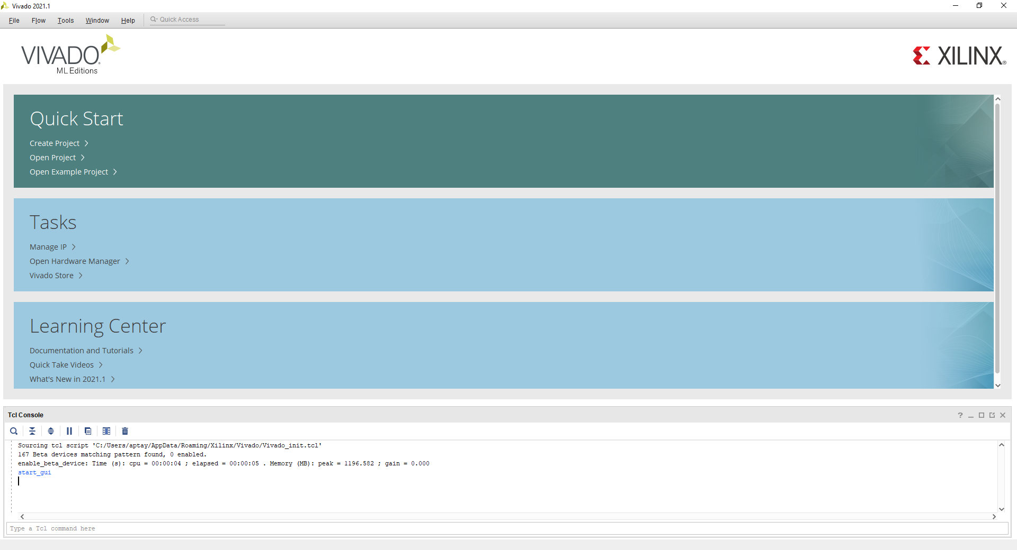
Lab 1: Understanding Vitis Project creation & Flow
Lab 1
Step 1 – Open Vivado 2021.1 – Click Create New Project

Slide 9
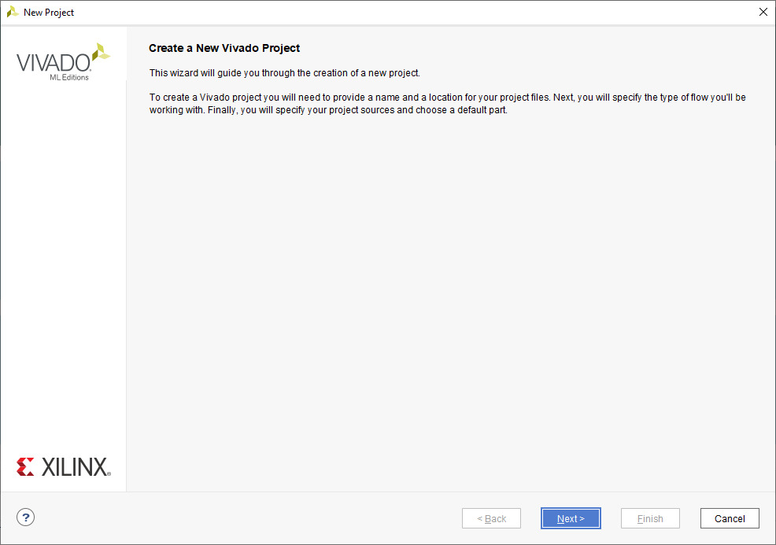
Lab 1: Understanding Vitis Project creation & Flow
Lab 1
Step 2 – Click Next

Slide 10
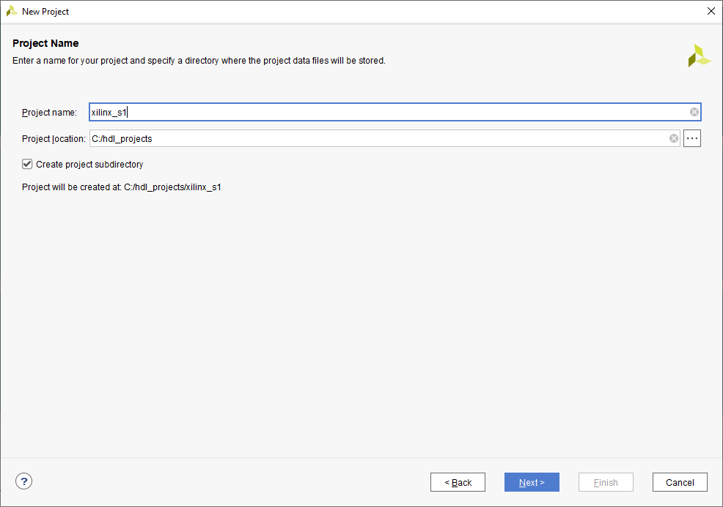
Lab 1: Understanding Vitis Project creation & Flow
Lab 1
Step 3 – Enter a project name and location to save the project, click next

Slide 11
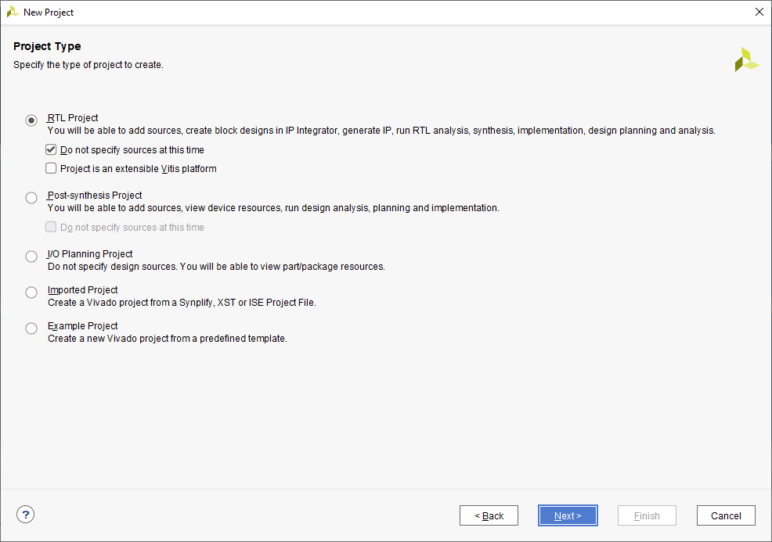
Lab 1: Understanding Vitis Project creation & Flow
Lab 1
Step 4 – Select RTL project and check do not include sources, click next

Slide 12
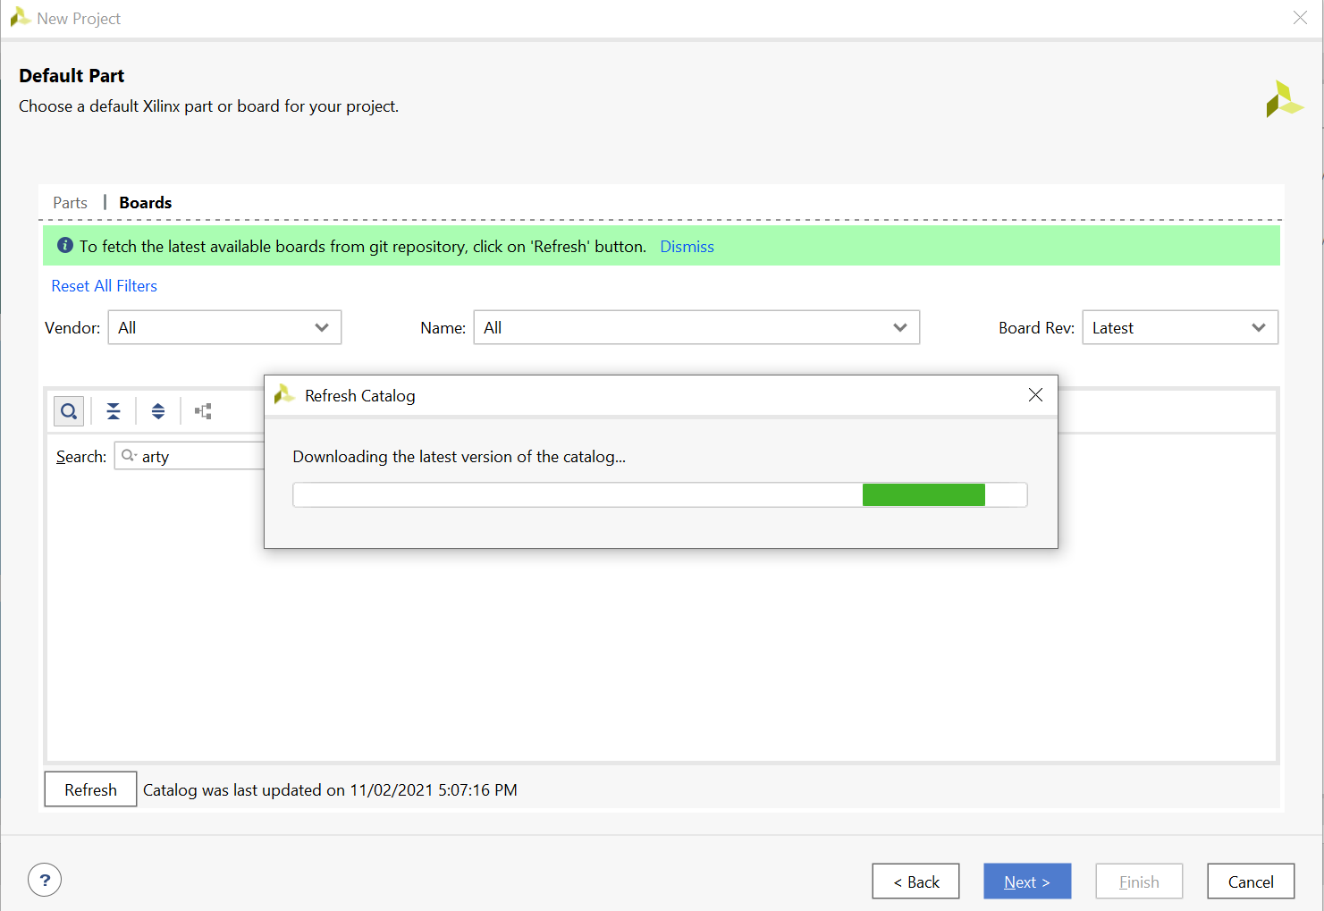
Lab 1: Understanding Vitis Project creation & Flow
Lab 1
Step 5 – If the Arty Z7 isn’t in the list of boards select Refresh and the board list will be updated

Slide 13
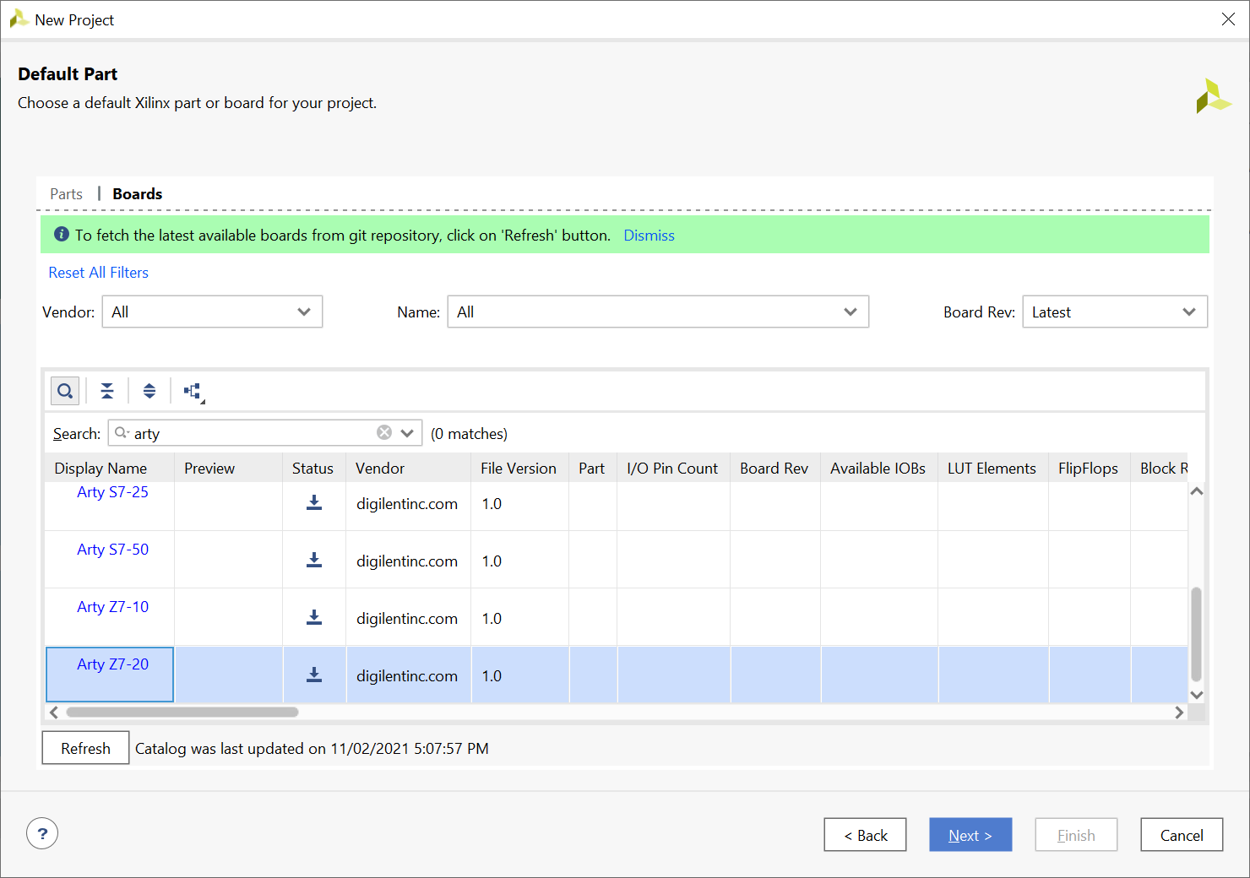
Lab 1: Understanding Vitis Project creation & Flow
Lab 1
Step 6 – Select the download and the board will install

Slide 14
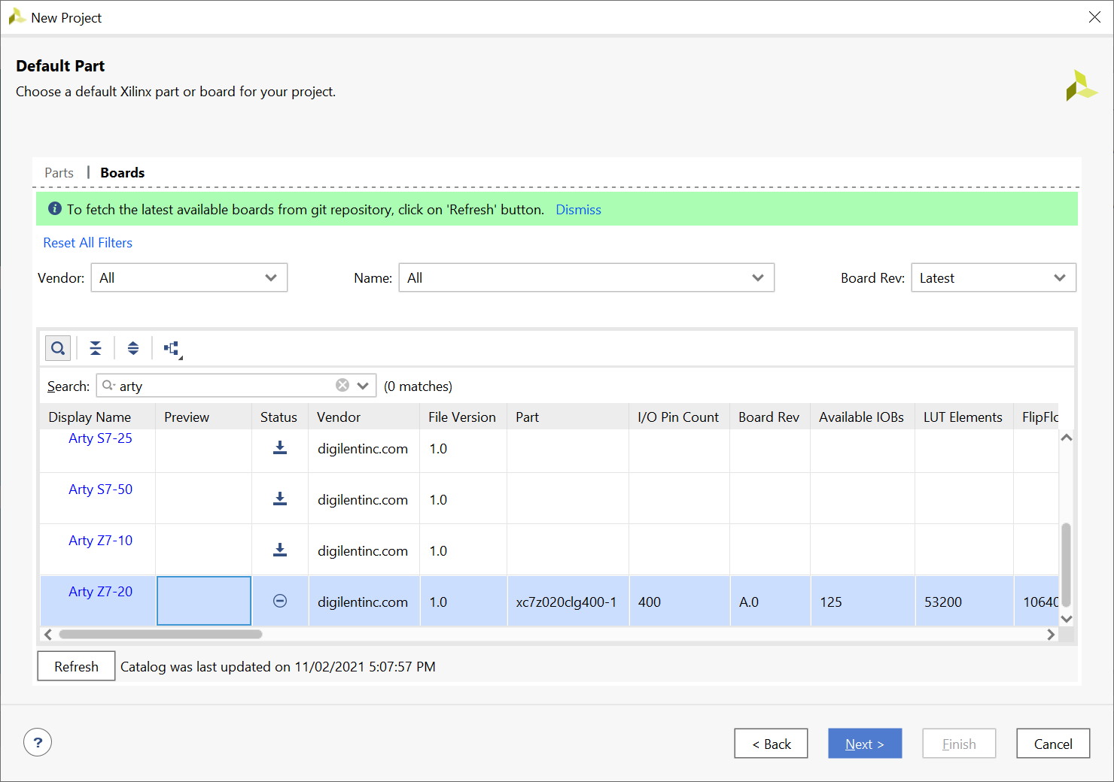
Lab 1: Understanding Vitis Project creation & Flow
Lab 1
Step 7 – Select Vendor Diglentinc and Arty Z7-20, click next

Slide 15
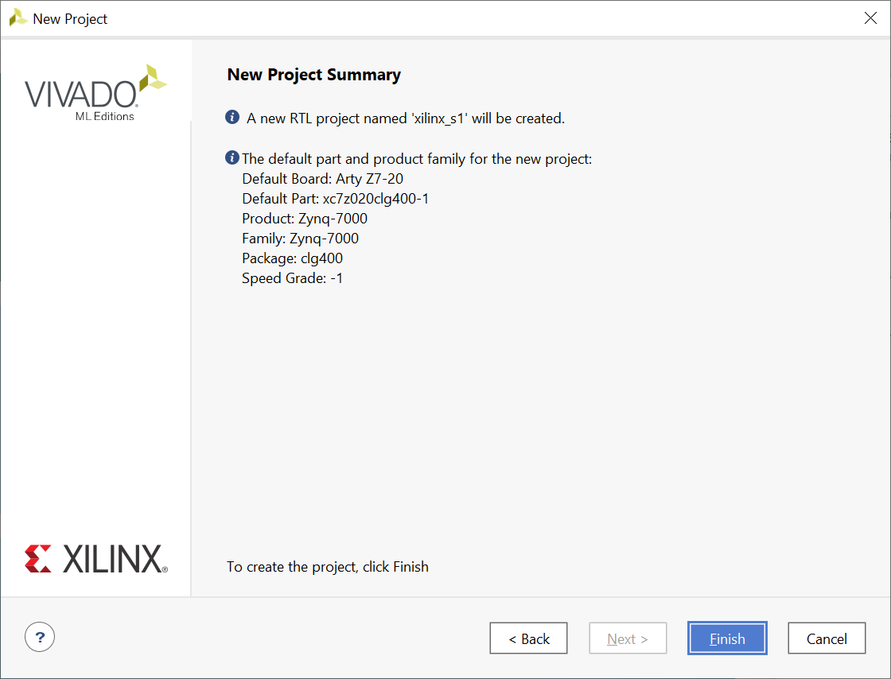
Lab 1: Understanding Vitis Project creation & Flow
Lab 1
Step 8 – Click Finish

Slide 16
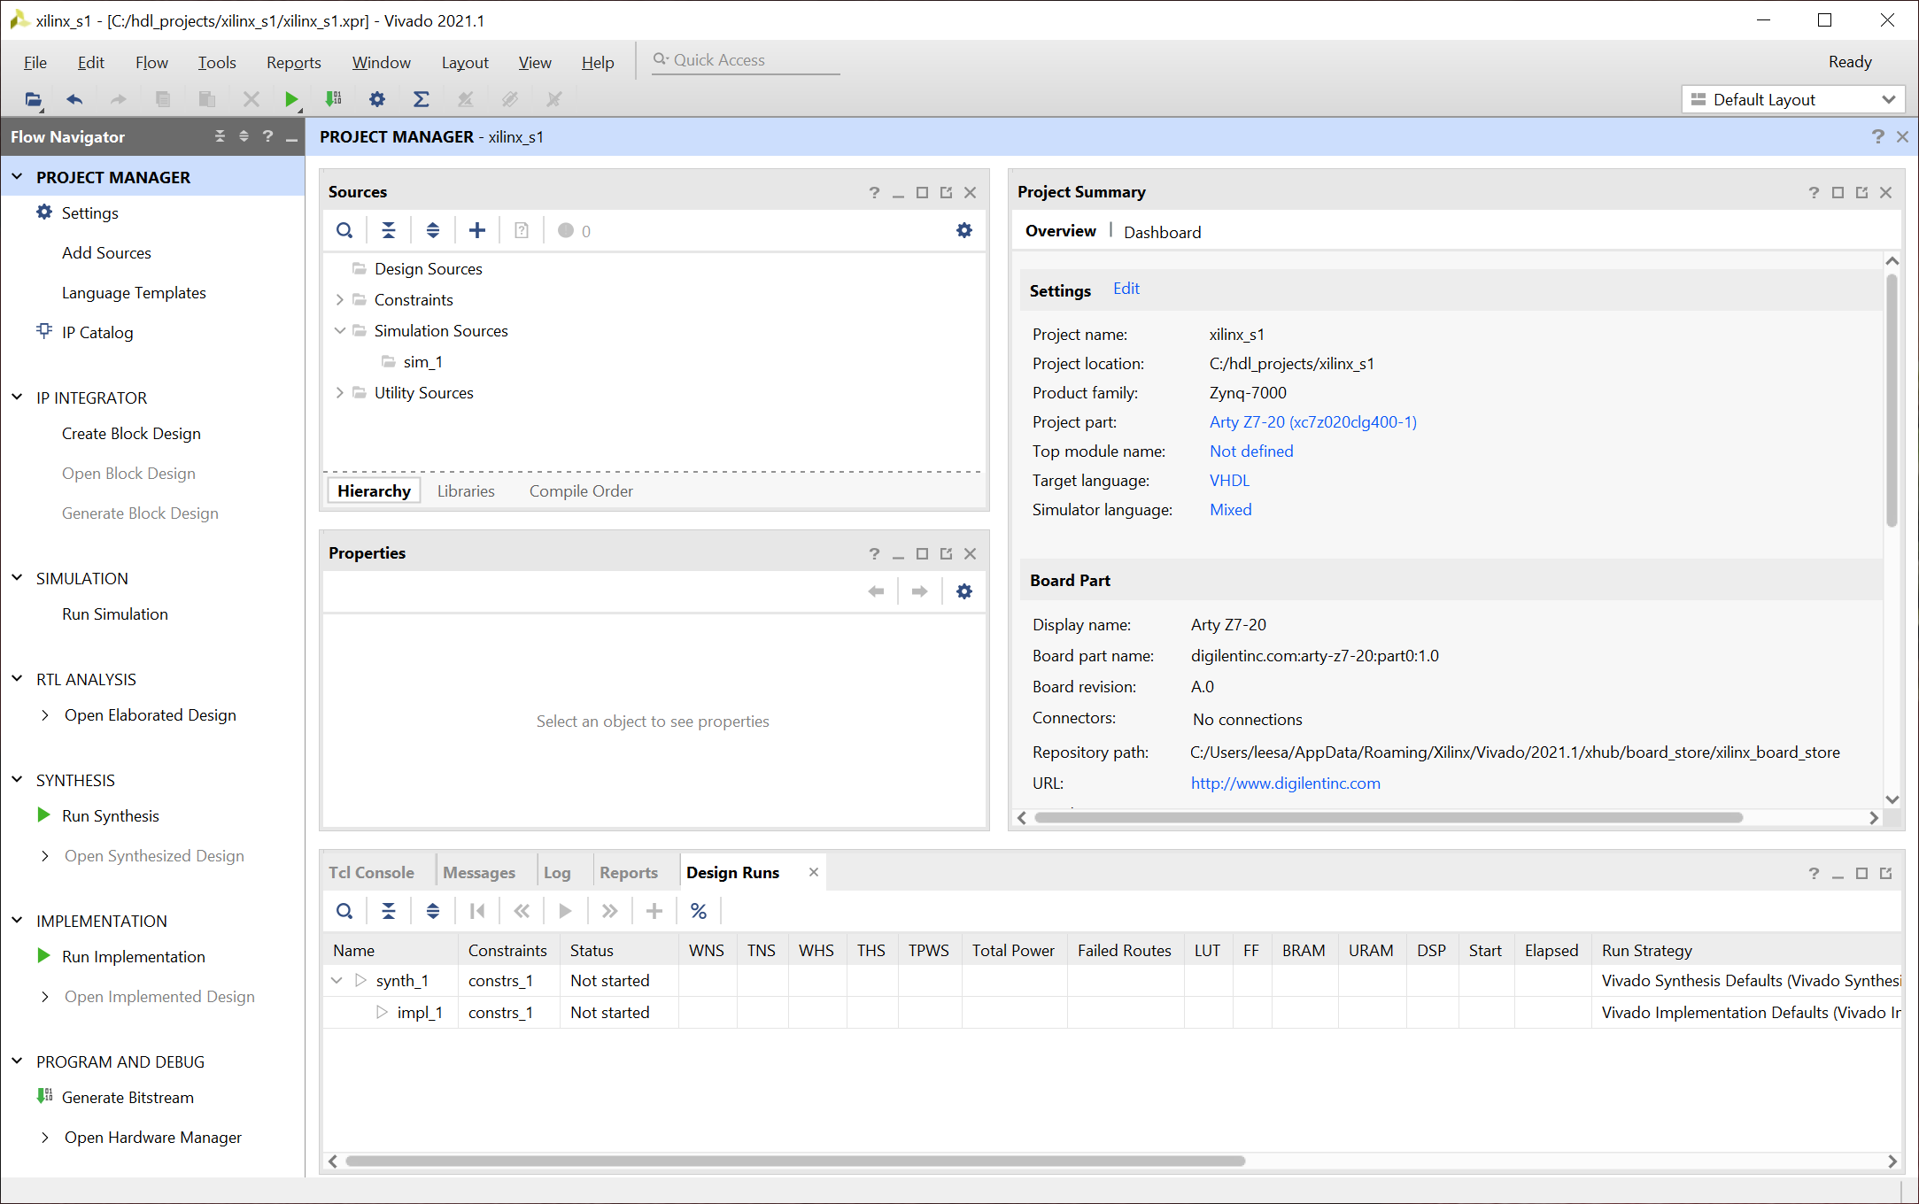
Lab 1: Understanding Vitis Project creation & Flow
Lab 1
Step 9 – Click on Create Block Diagram – This will open IP editor

Slide 17
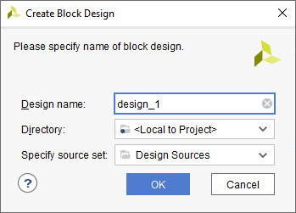
Lab 1: Understanding Vitis Project creation & Flow
Lab 1
Step 10 – Leave the settings as default and click OK

Slide 18
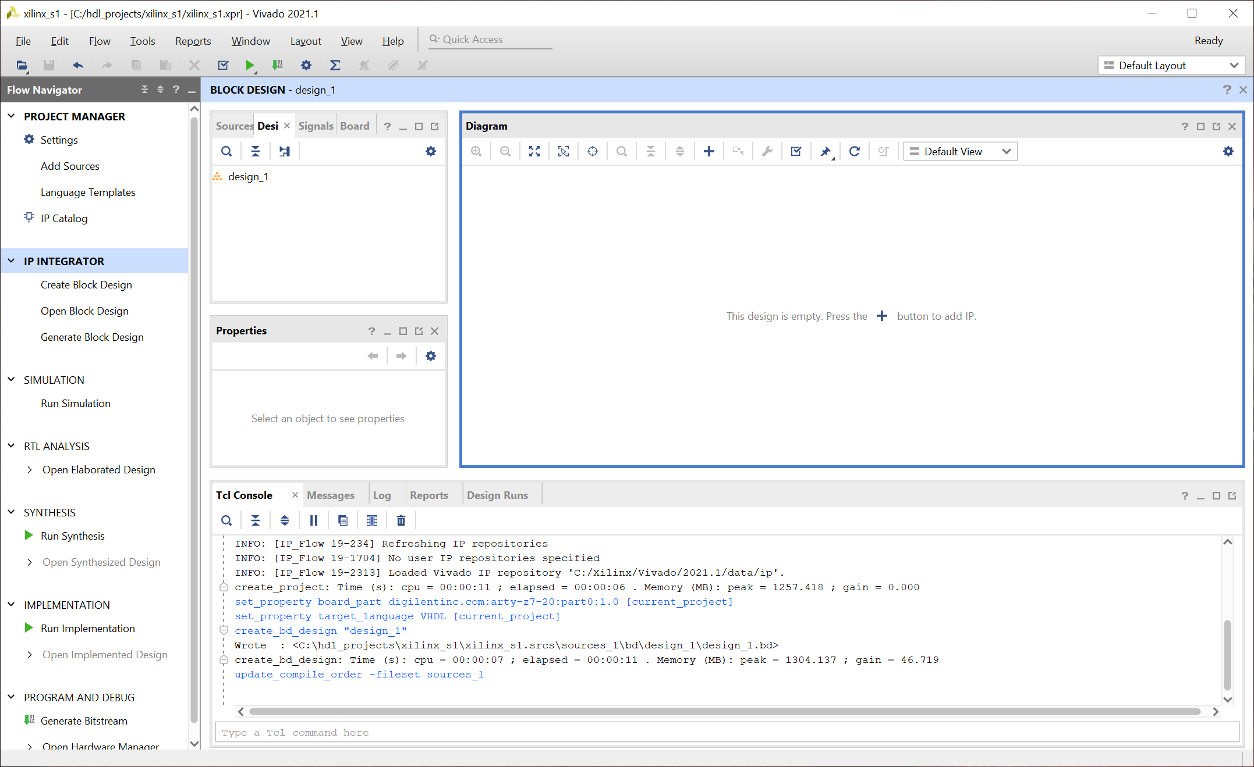
Lab 1: Understanding Vitis Project creation & Flow
Lab 1
Step 11 – Click on the + button to open the IP list

Slide 19
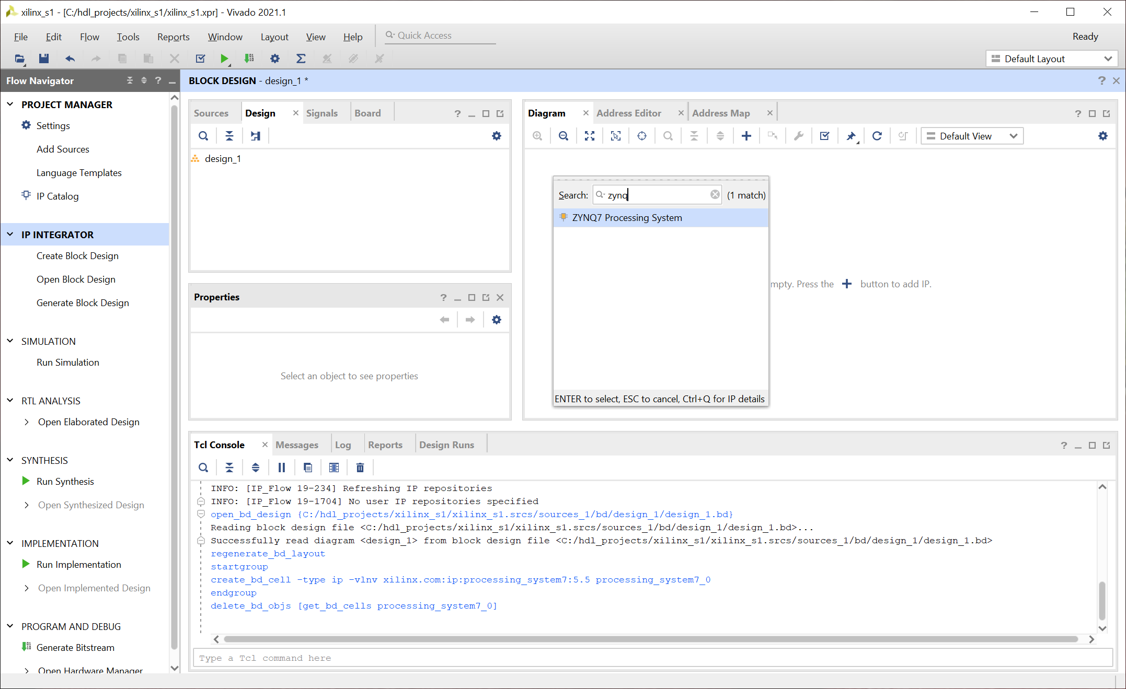
Lab 1: Understanding Vitis Project creation & Flow
Lab 1
Step 12 – In the search bar, type Ultra and select the Zynq UltraScale+ MPSoC block. Double click on this to insert the IP block.

Slide 20
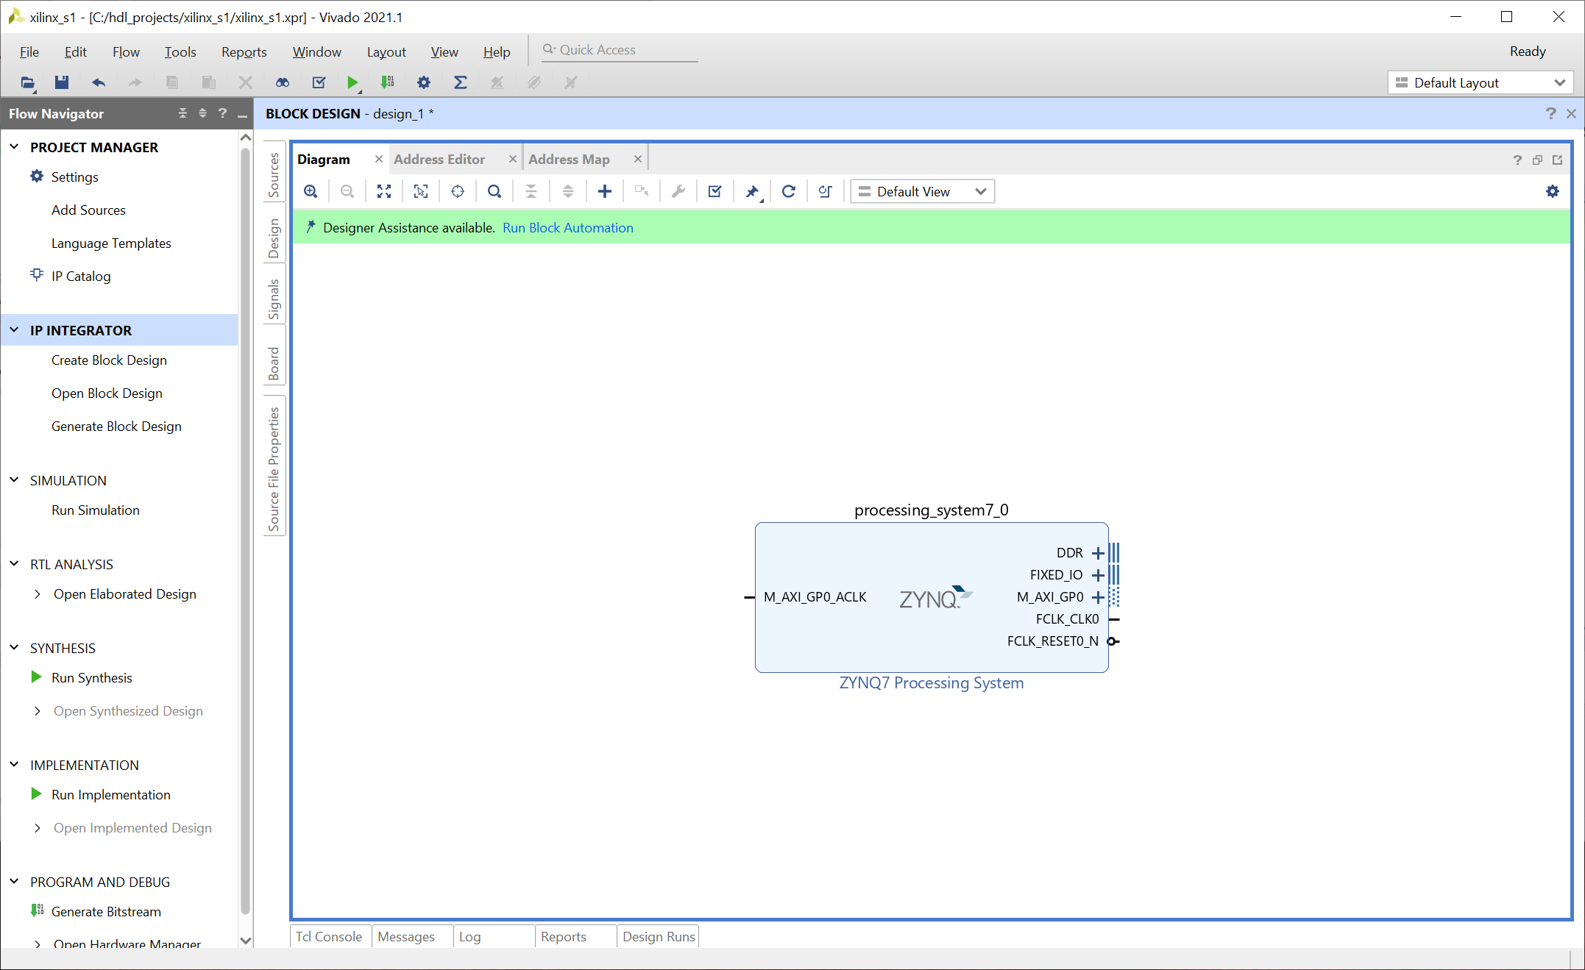
Lab 1: Understanding Vitis Project creation & Flow
Lab 1
Step 13 – Select Run Block Automation – This will configure the Processing System for the ArtyZ7 setting e.g. DDR timing, Clocking etc.

Slide 21
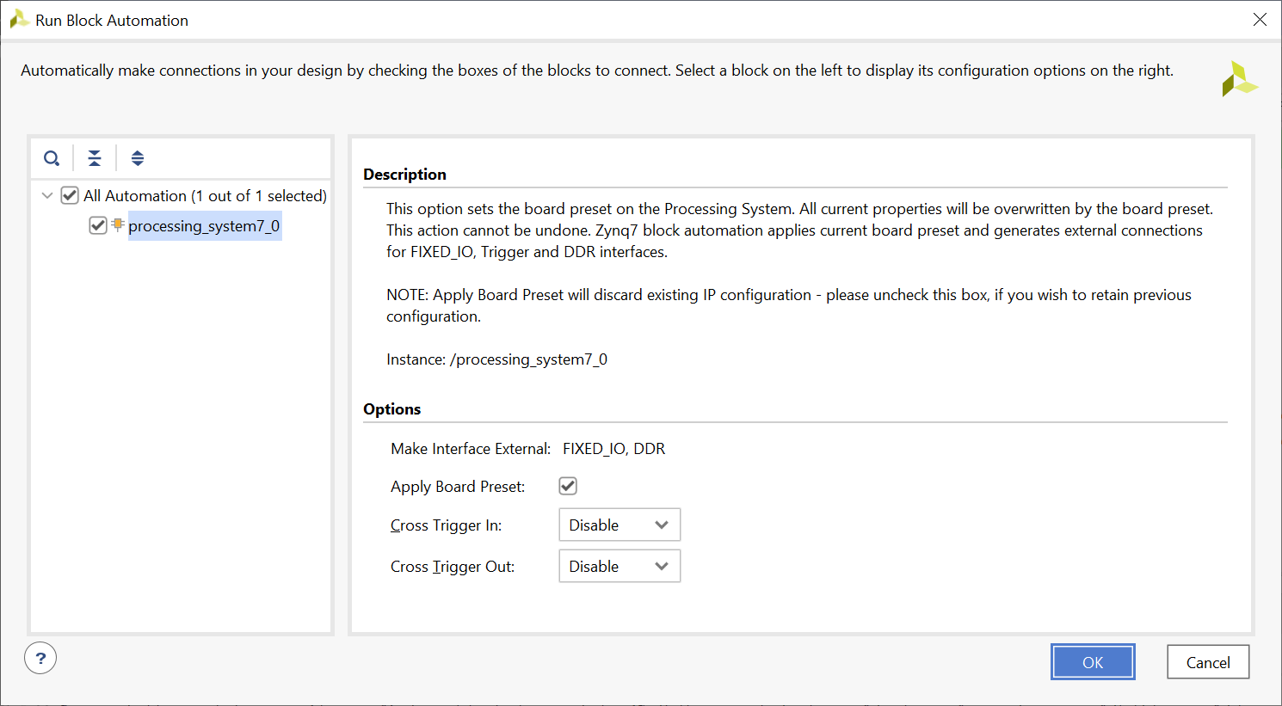
Lab 1: Understanding Vitis Project creation & Flow
Lab 1
Step 14 – Click on the OK button, the automation will run and configure the processing block for the ArtyZ7.

Slide 22
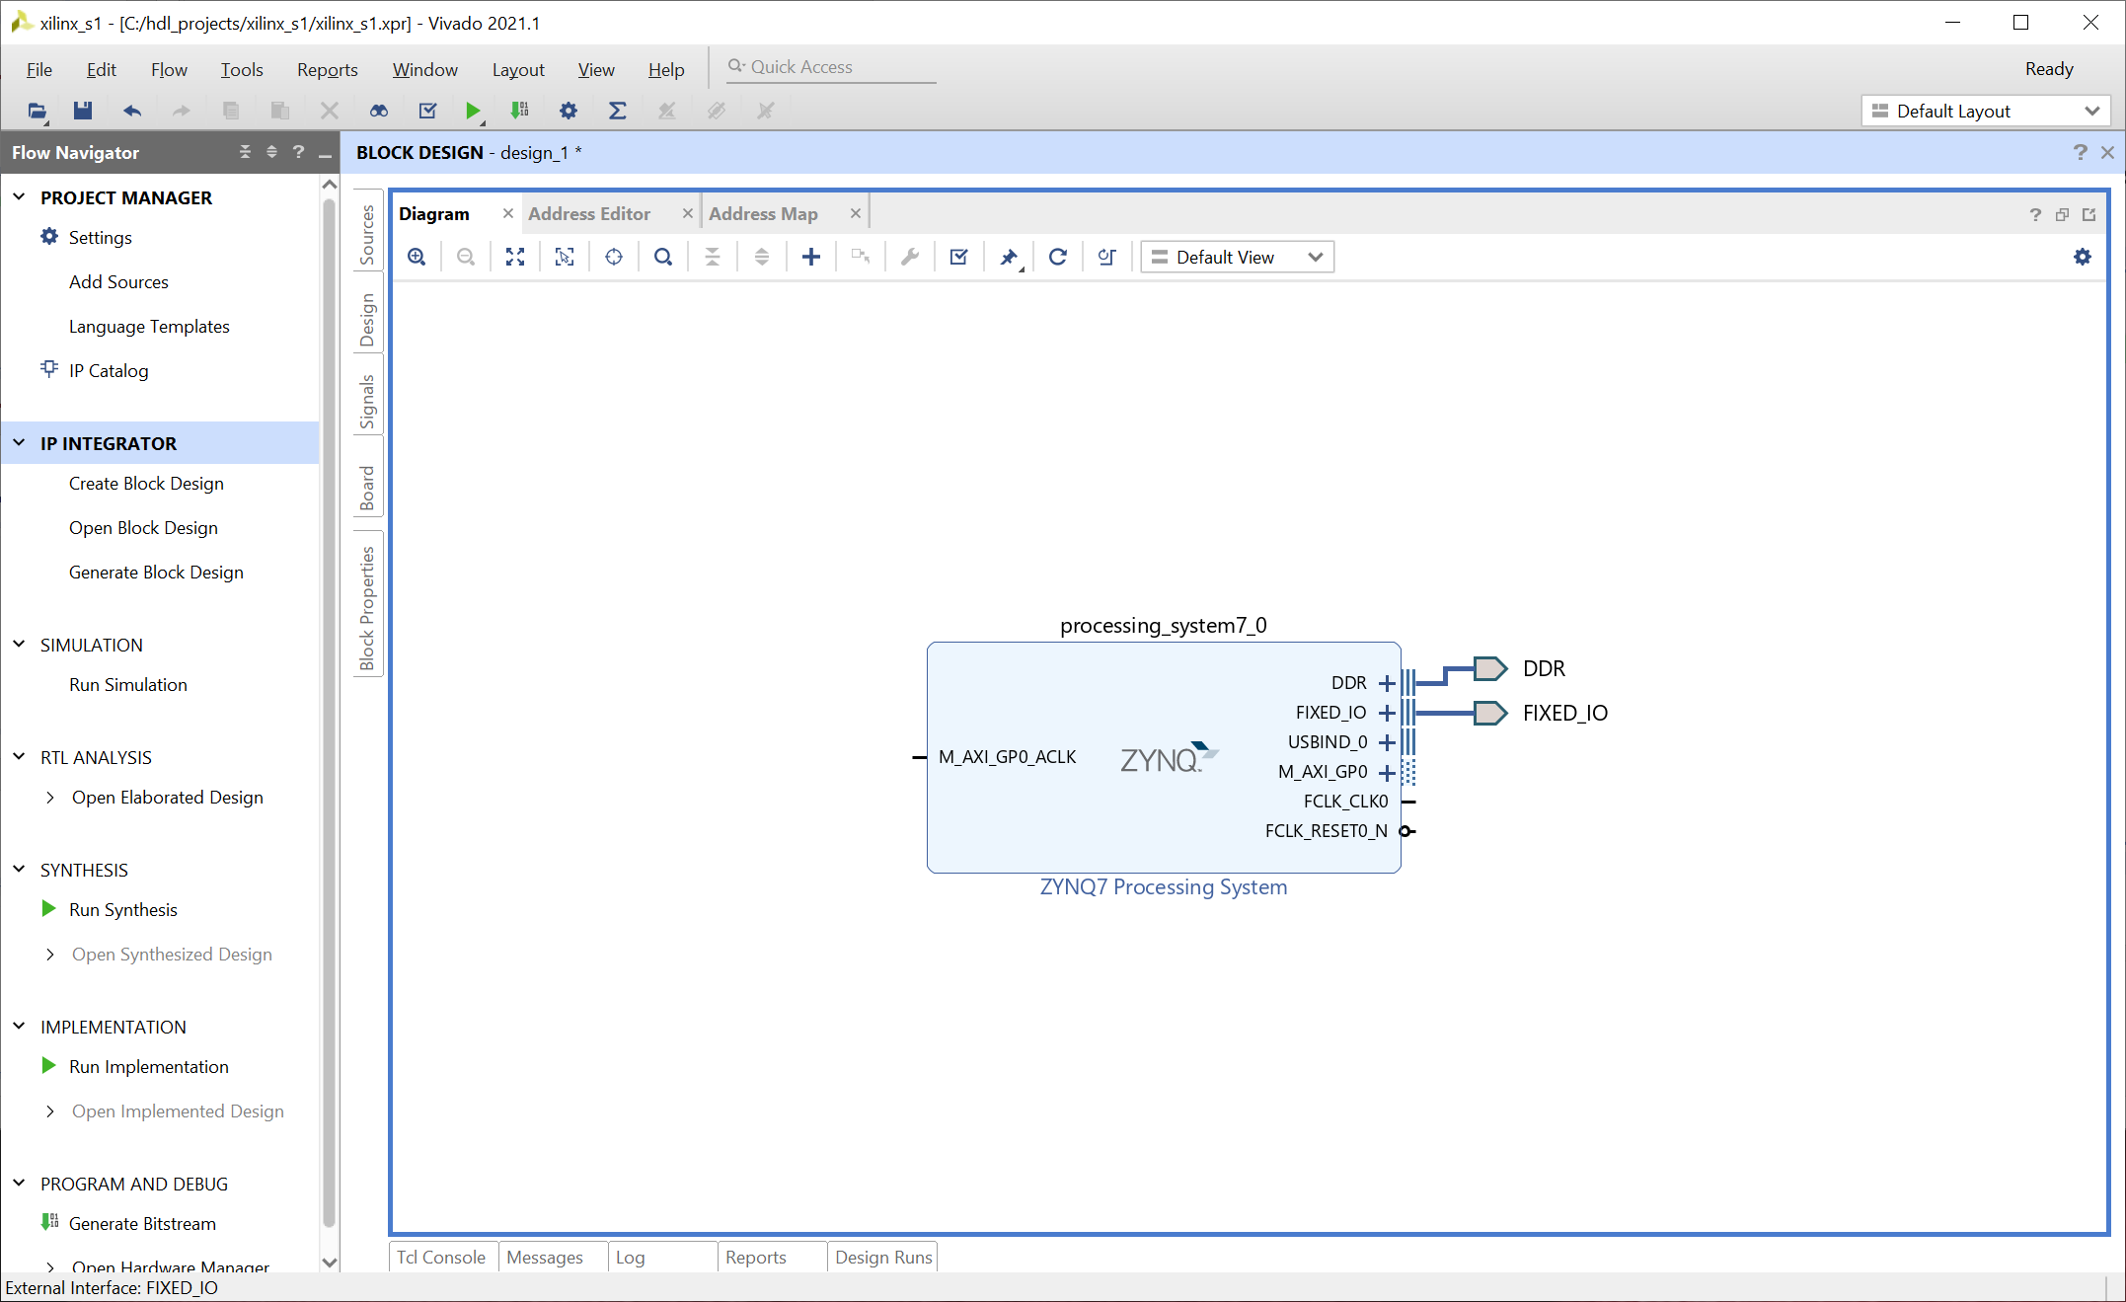
Lab 1: Understanding Vitis Project creation & Flow
Lab 1
Step 15 – Click on the + Symbol

Slide 23
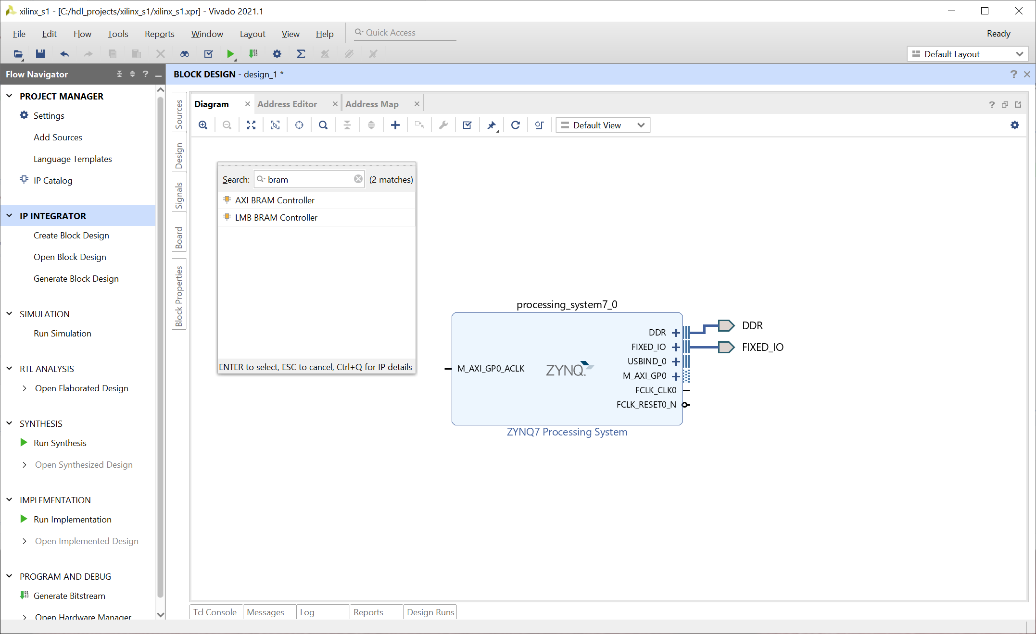
Lab 1: Understanding Vitis Project creation & Flow
Lab 1
Step 16 – Type in BRAM and double click on AXI BRAM Controller to add the IP

Slide 24
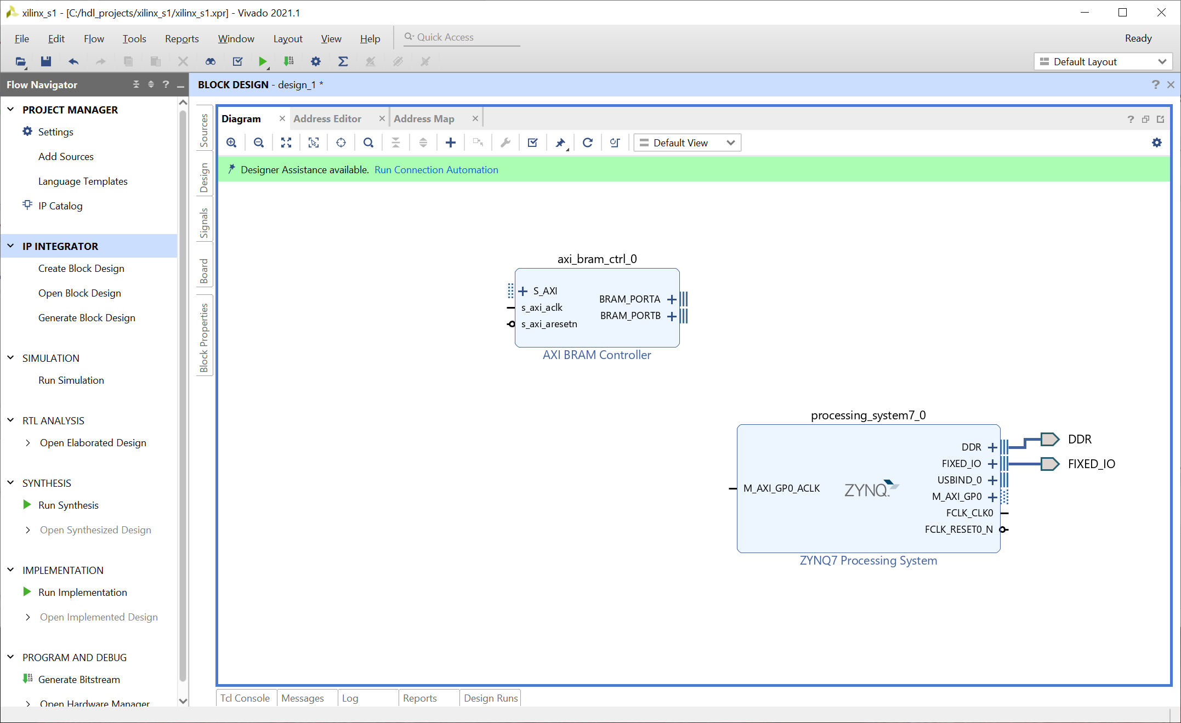
Lab 1: Understanding Vitis Project creation & Flow
Lab 1
Step 17 – Double click on the AXI BRAM Controller

Slide 25
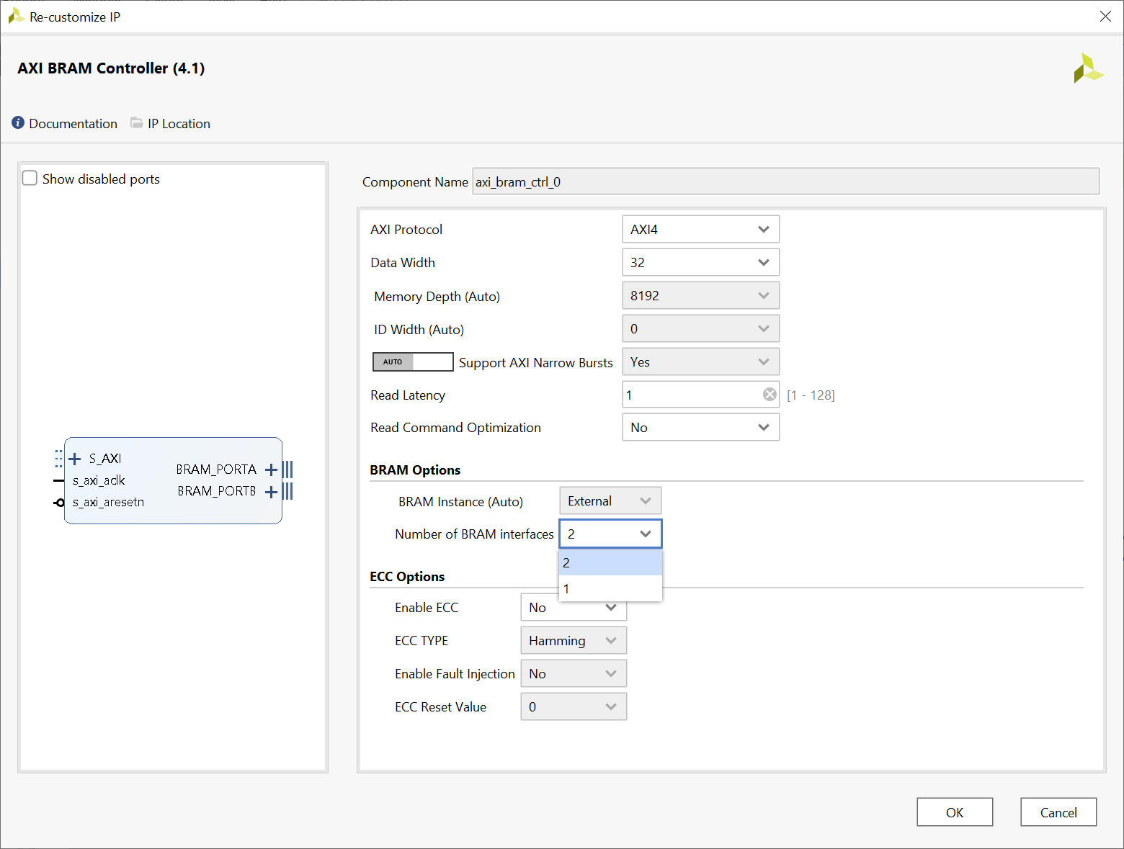
Lab 1: Understanding Vitis Project creation & Flow
Lab 1
Step 18 – Change the Number of BRAM Interfaces to 1, click OK

Slide 26
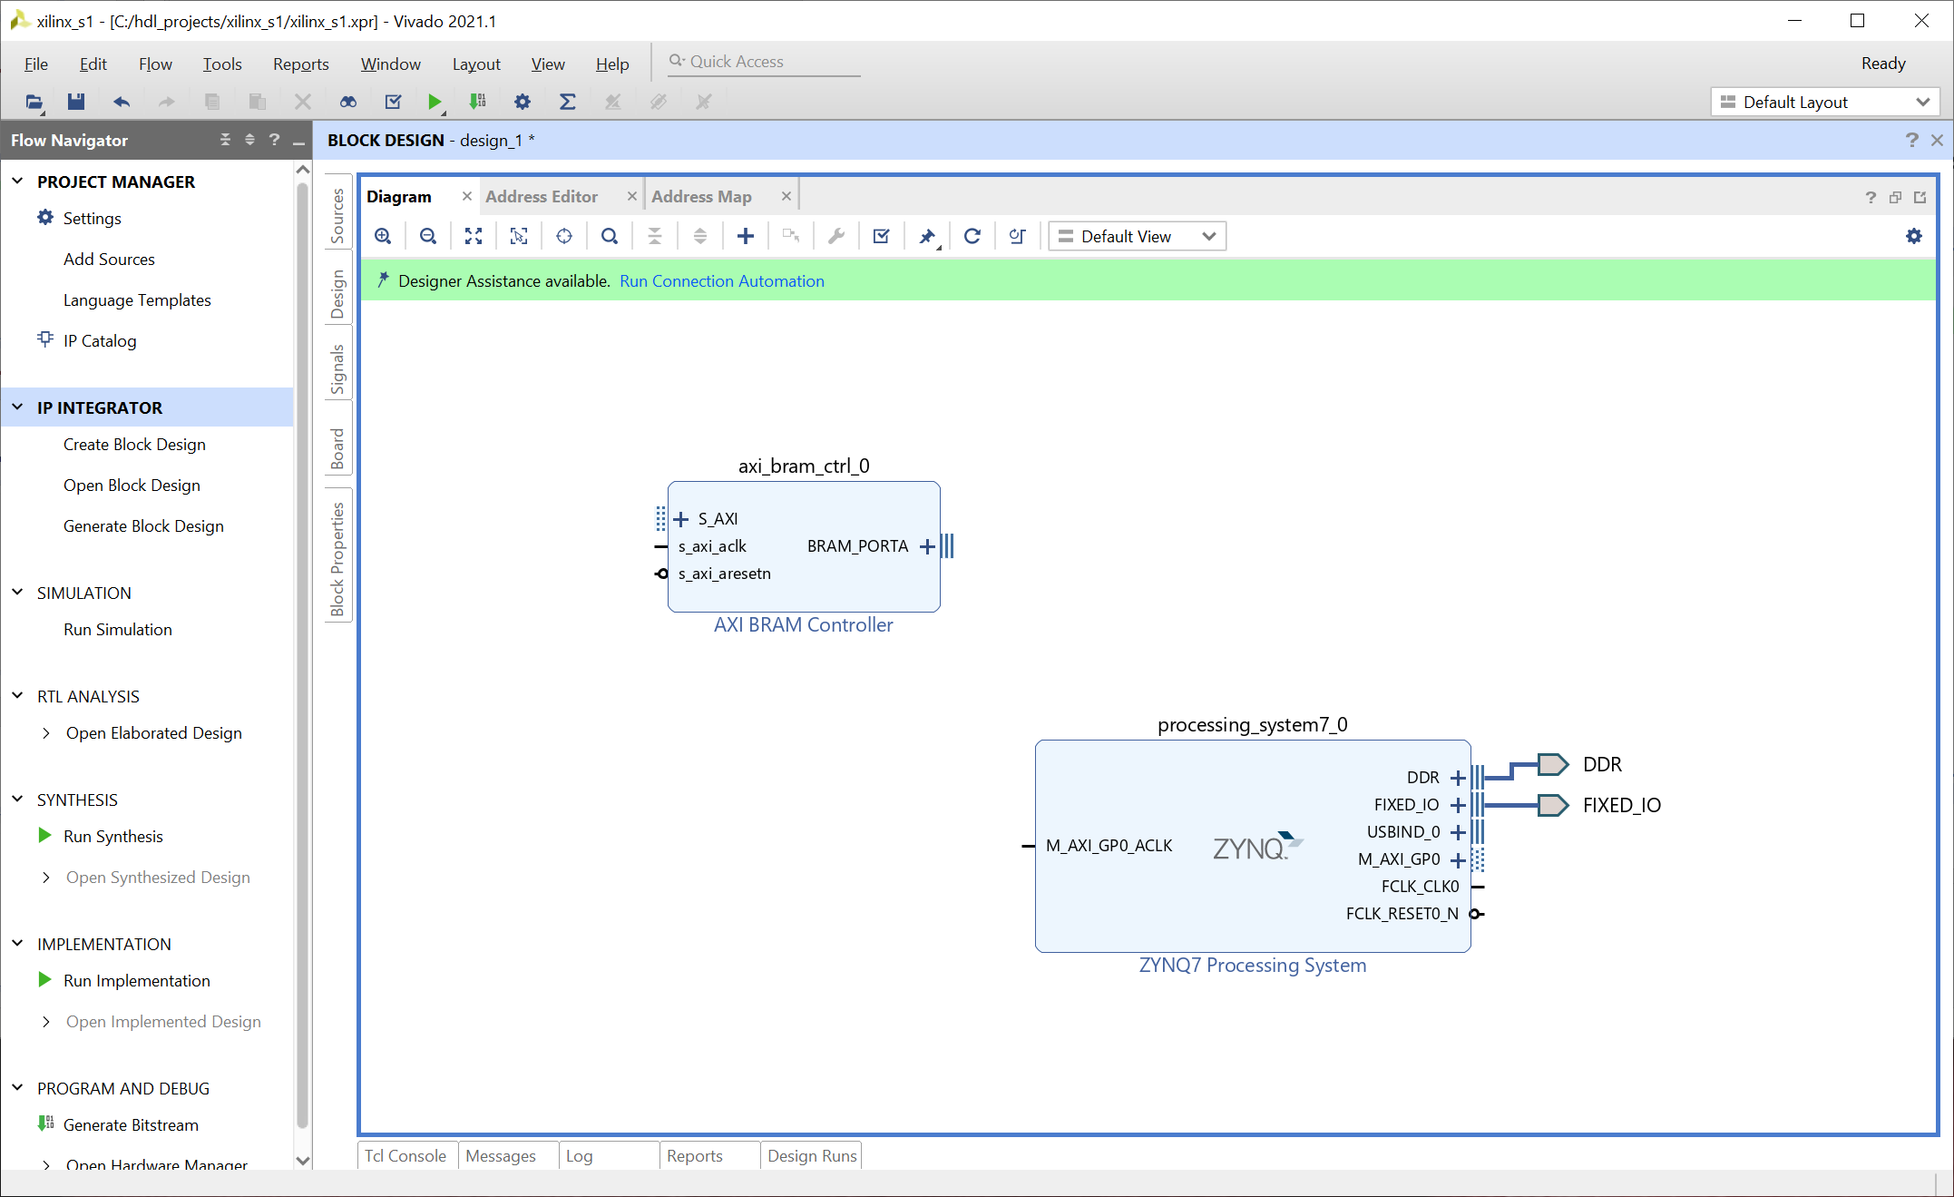
Lab 1: Understanding Vitis Project creation & Flow
Lab 1
Step 19 – Click on Run Connection Automation

Slide 27
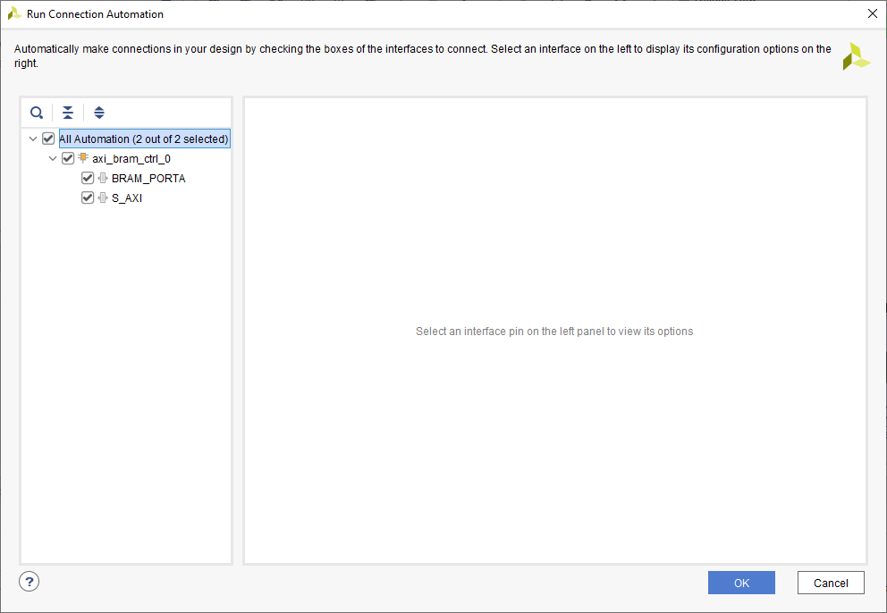
Lab 1: Understanding Vitis Project creation & Flow
Lab 1
Step 20 – Check all the boxes, click OK

Slide 28
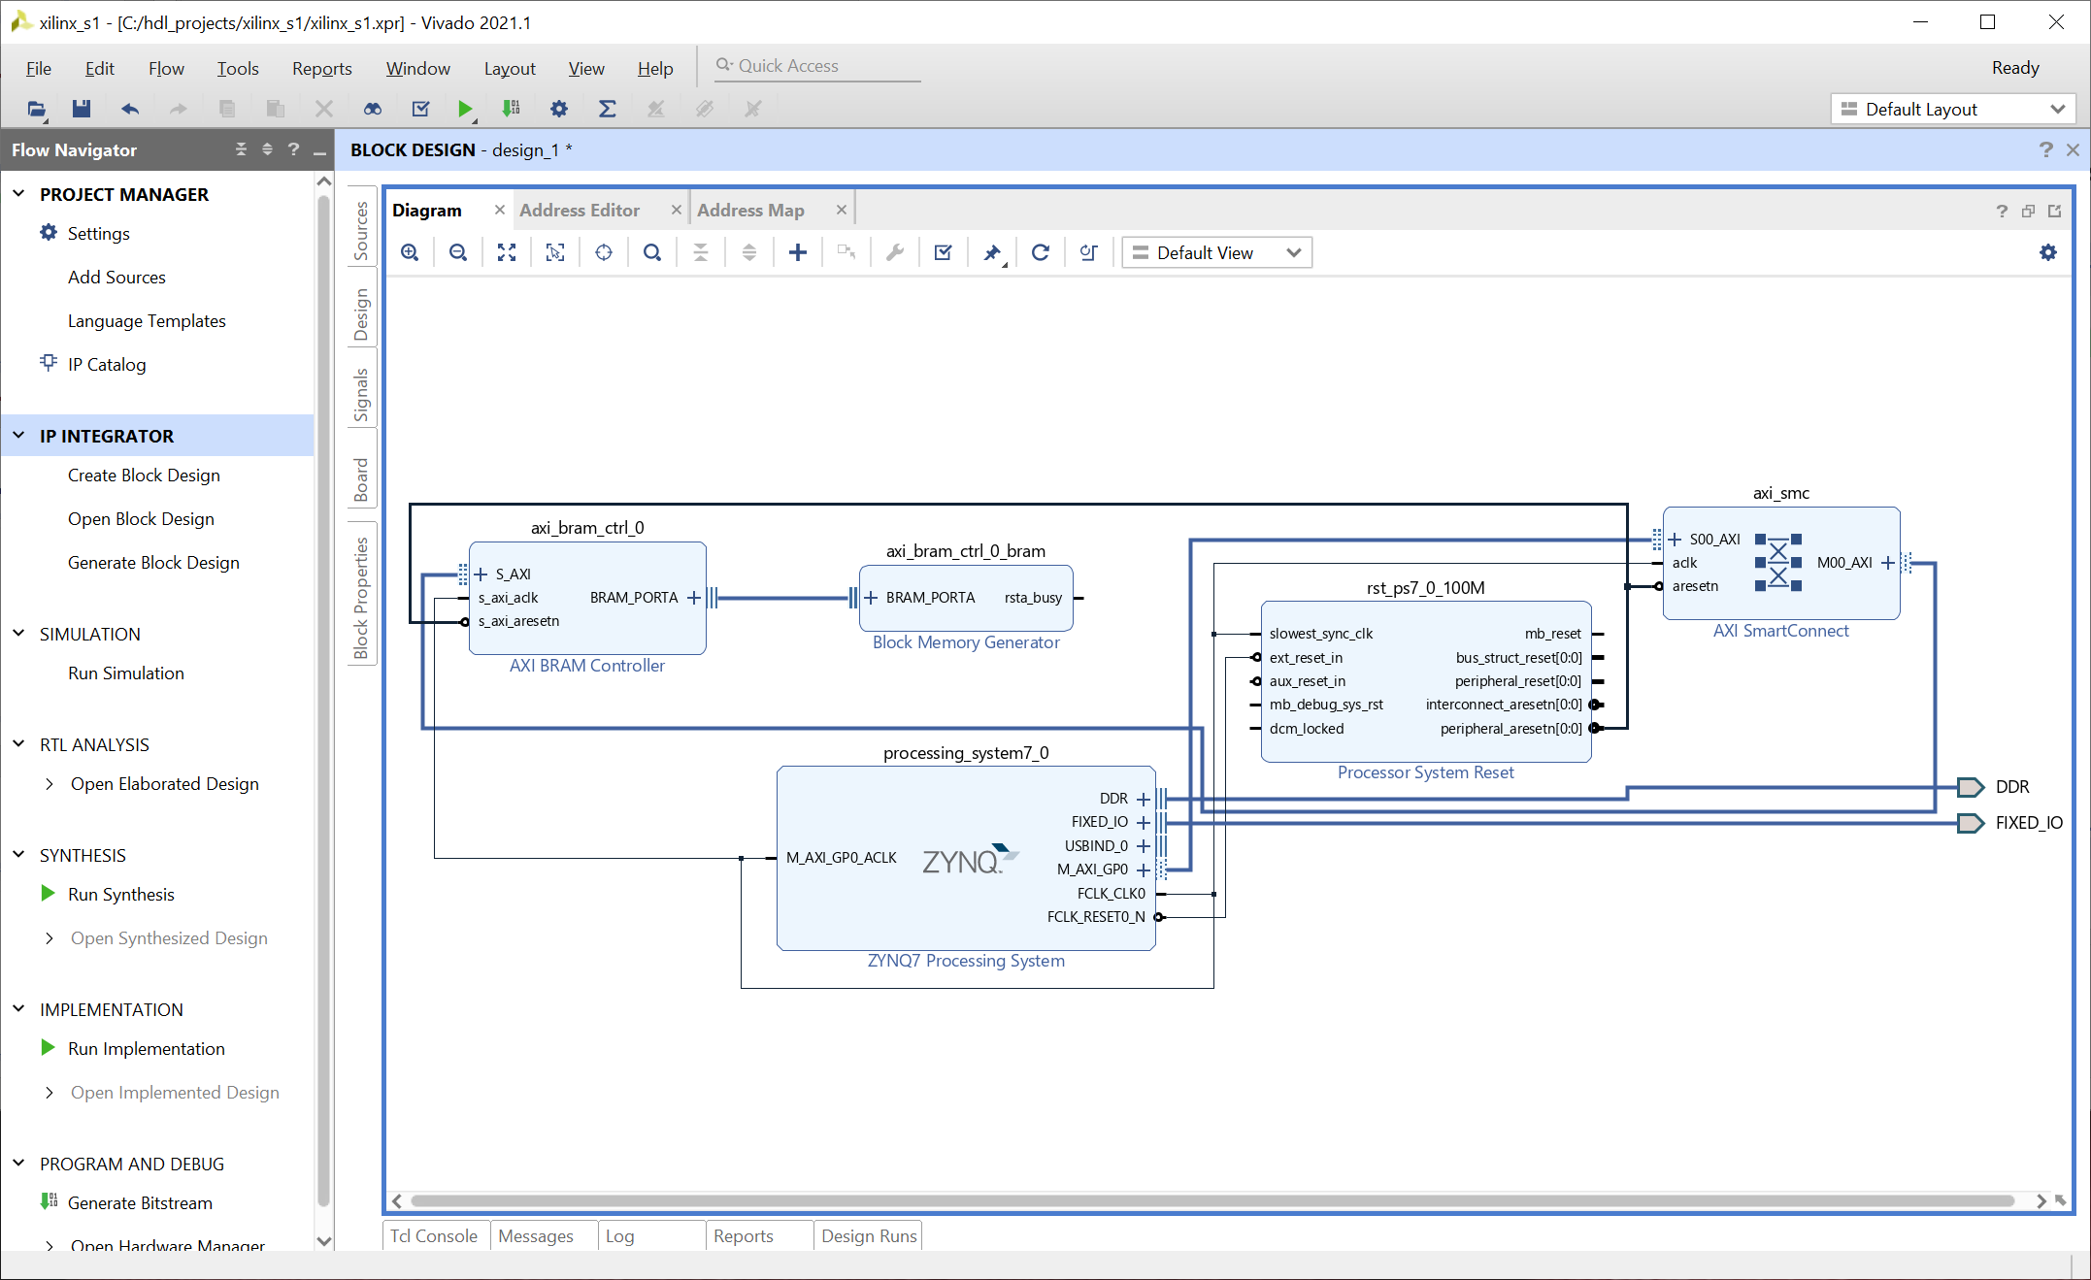
Lab 1: Understanding Vitis Project creation & Flow
Lab 1
Step 21 – Click on the Regenerate Layout – This will mage the diagram more logical

Slide 29
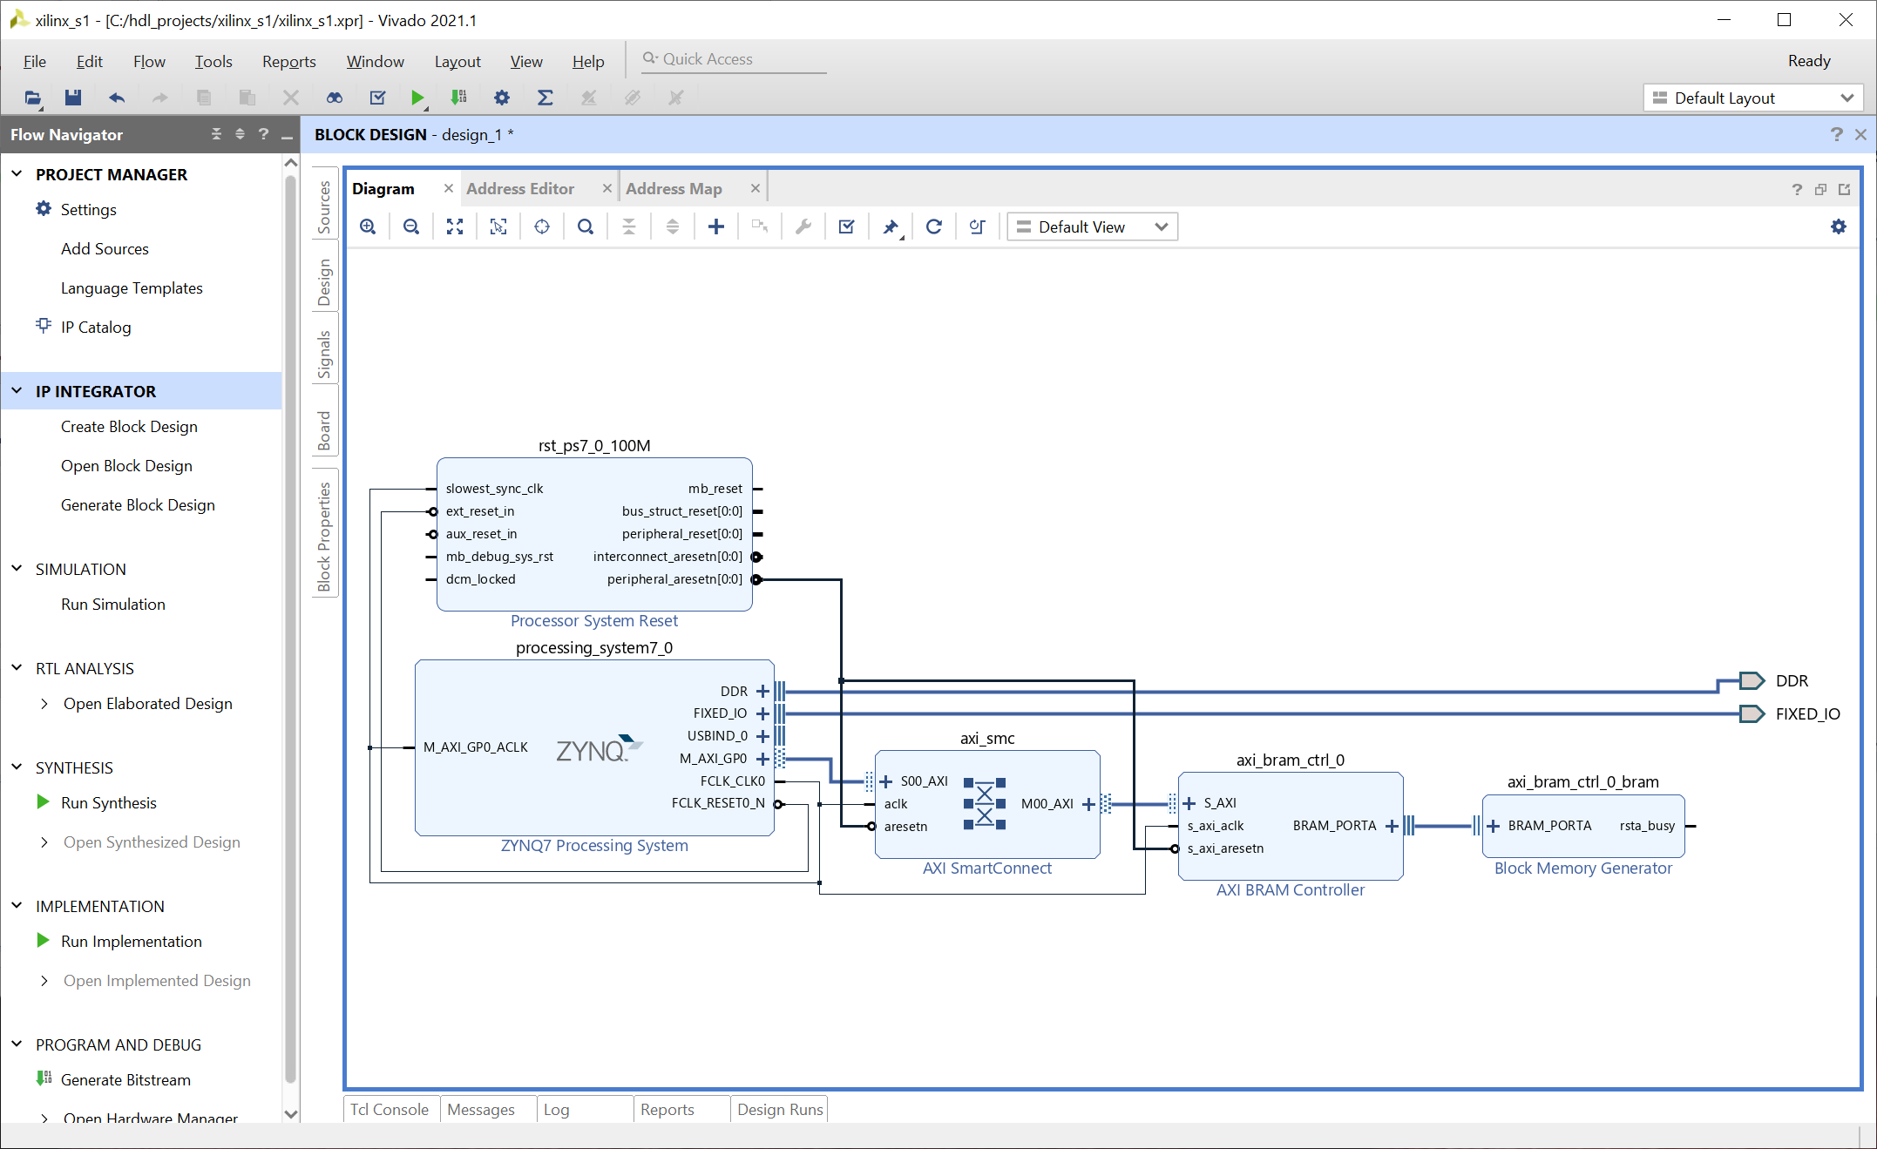
Lab 1: Understanding Vitis Project creation & Flow
Lab 1
Step 22 – Double Click on the BRAM Block

Slide 30
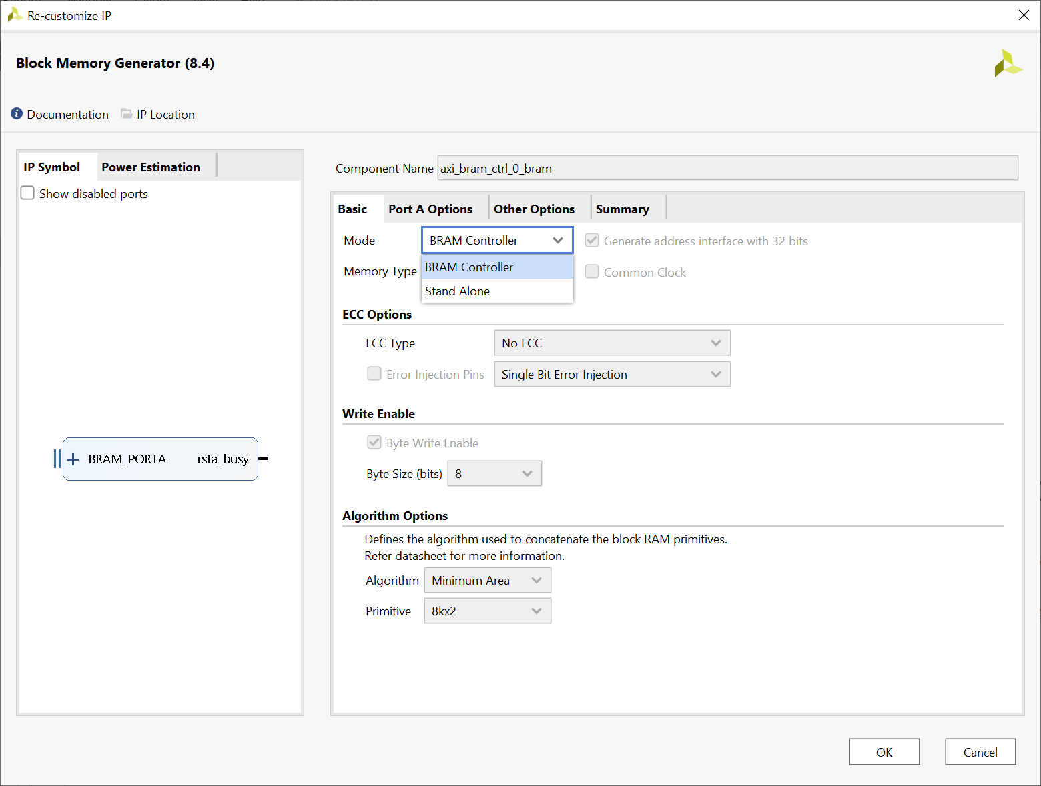
Lab 1: Understanding Vitis Project creation & Flow
Lab 1
Step 23 – Change the mode to Standalone, make sure check use 32 bit addressing is set

Slide 31
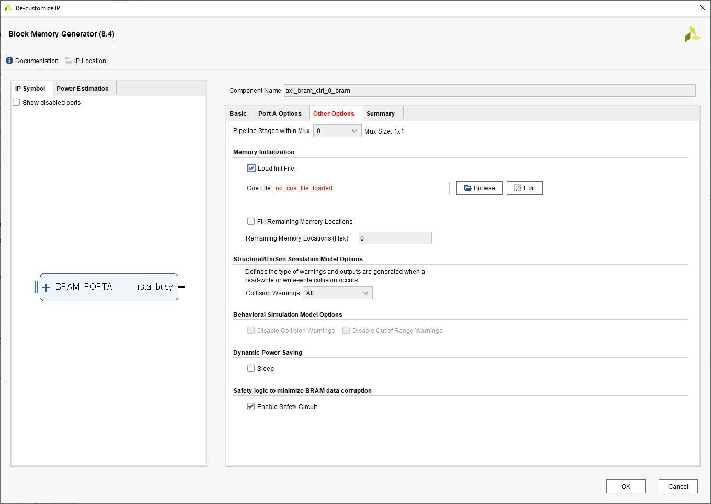
Lab 1: Understanding Vitis Project creation & Flow
Lab 1
Step 24 – Check load Init File, click on edit continue to step 25

Slide 32
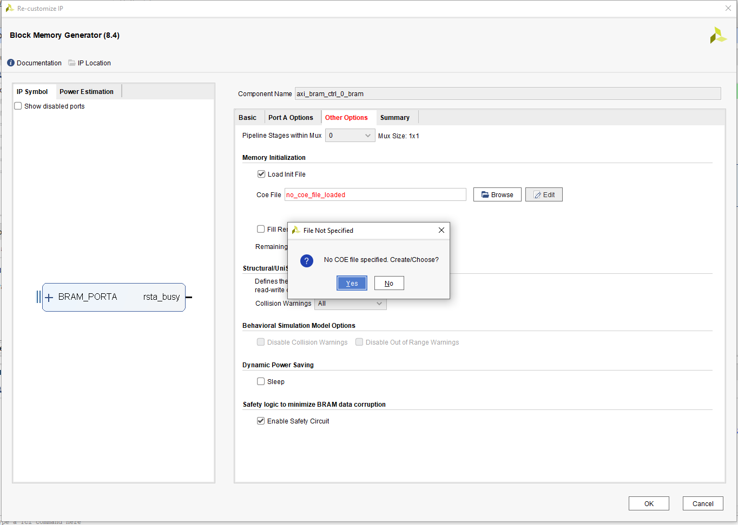
Lab 1: Understanding Vitis Project creation & Flow
Lab 1
Step 25 – Click Yes

Slide 33
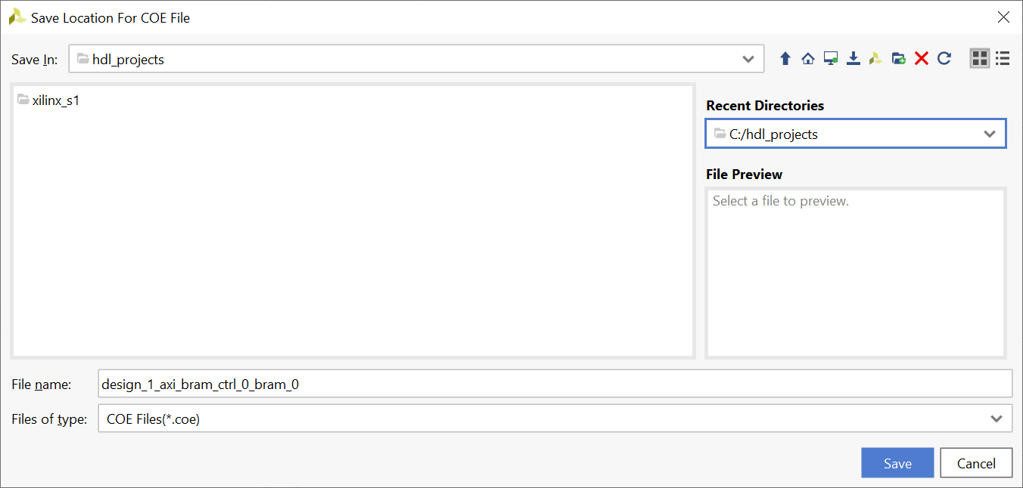
Lab 1: Understanding Vitis Project creation & Flow
Lab 1
Step 26 – Select the project folder and continue to step 27

Slide 34
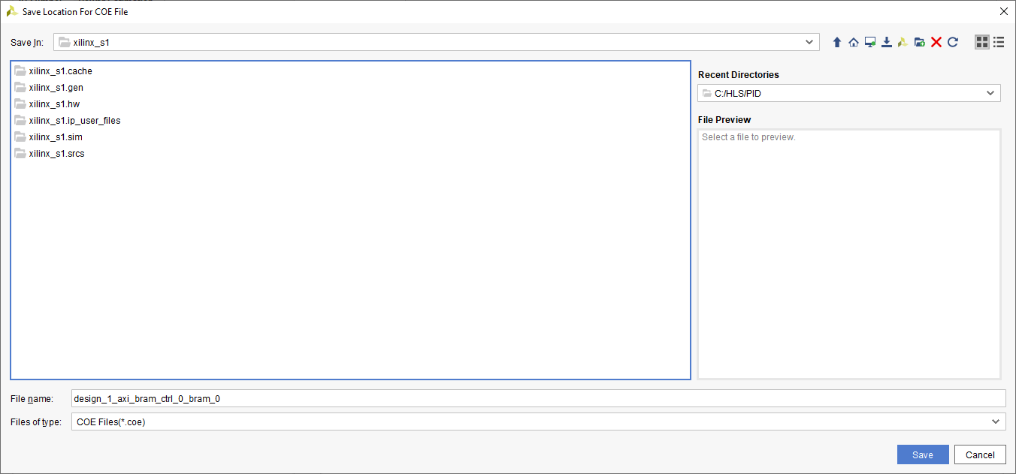
Lab 1: Understanding Vitis Project creation & Flow
Lab 1
Step 27 – Select a location inside the project to save the file and select OK

Slide 35
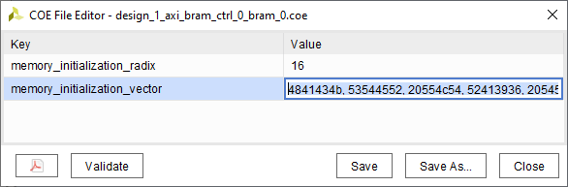
Lab 1: Understanding Vitis Project creation & Flow
Lab 1
Step 28 – Enter the following
Memory Initialization Radix = 16
Memory Initialization Vector = 4841434b, 53544552, 20554c54, 52413936, 20545554, 4f524941, 0000004c,
Click Save, then Validate before closing

Slide 36
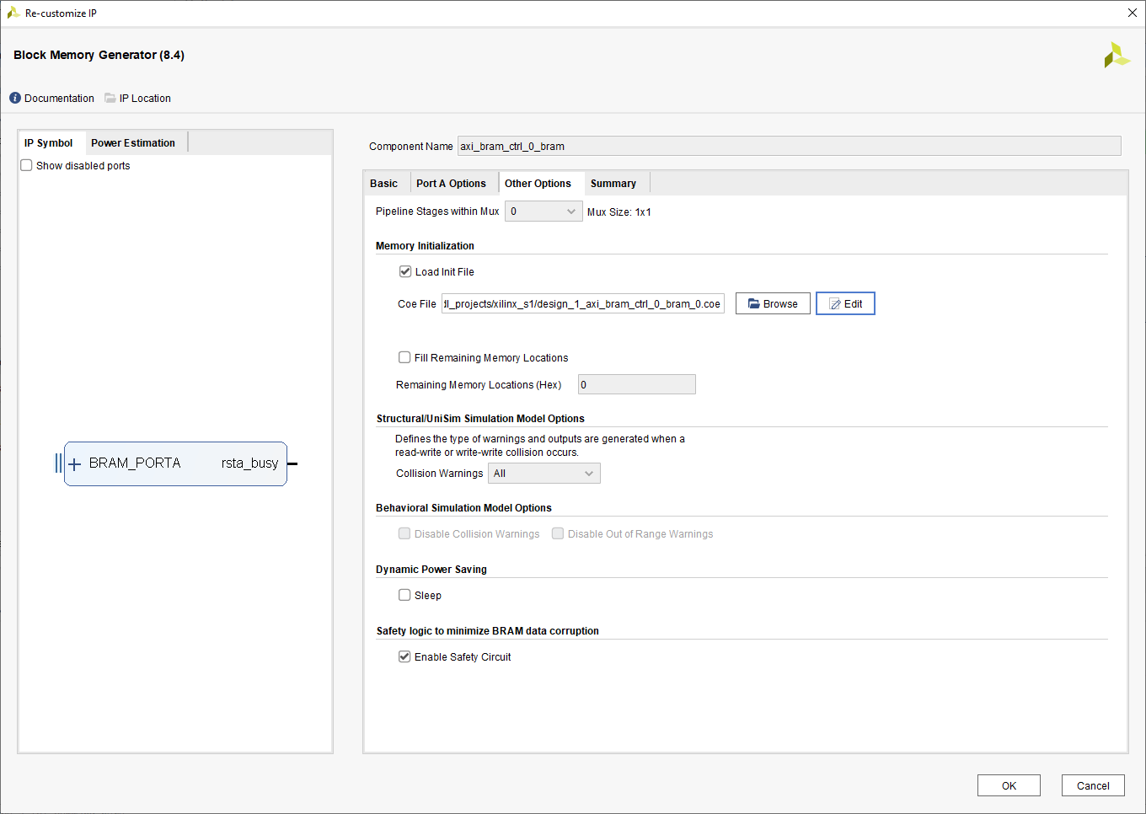
Lab 1: Understanding Vitis Project creation & Flow
Lab 1
Step 29 – Click OK

Slide 37
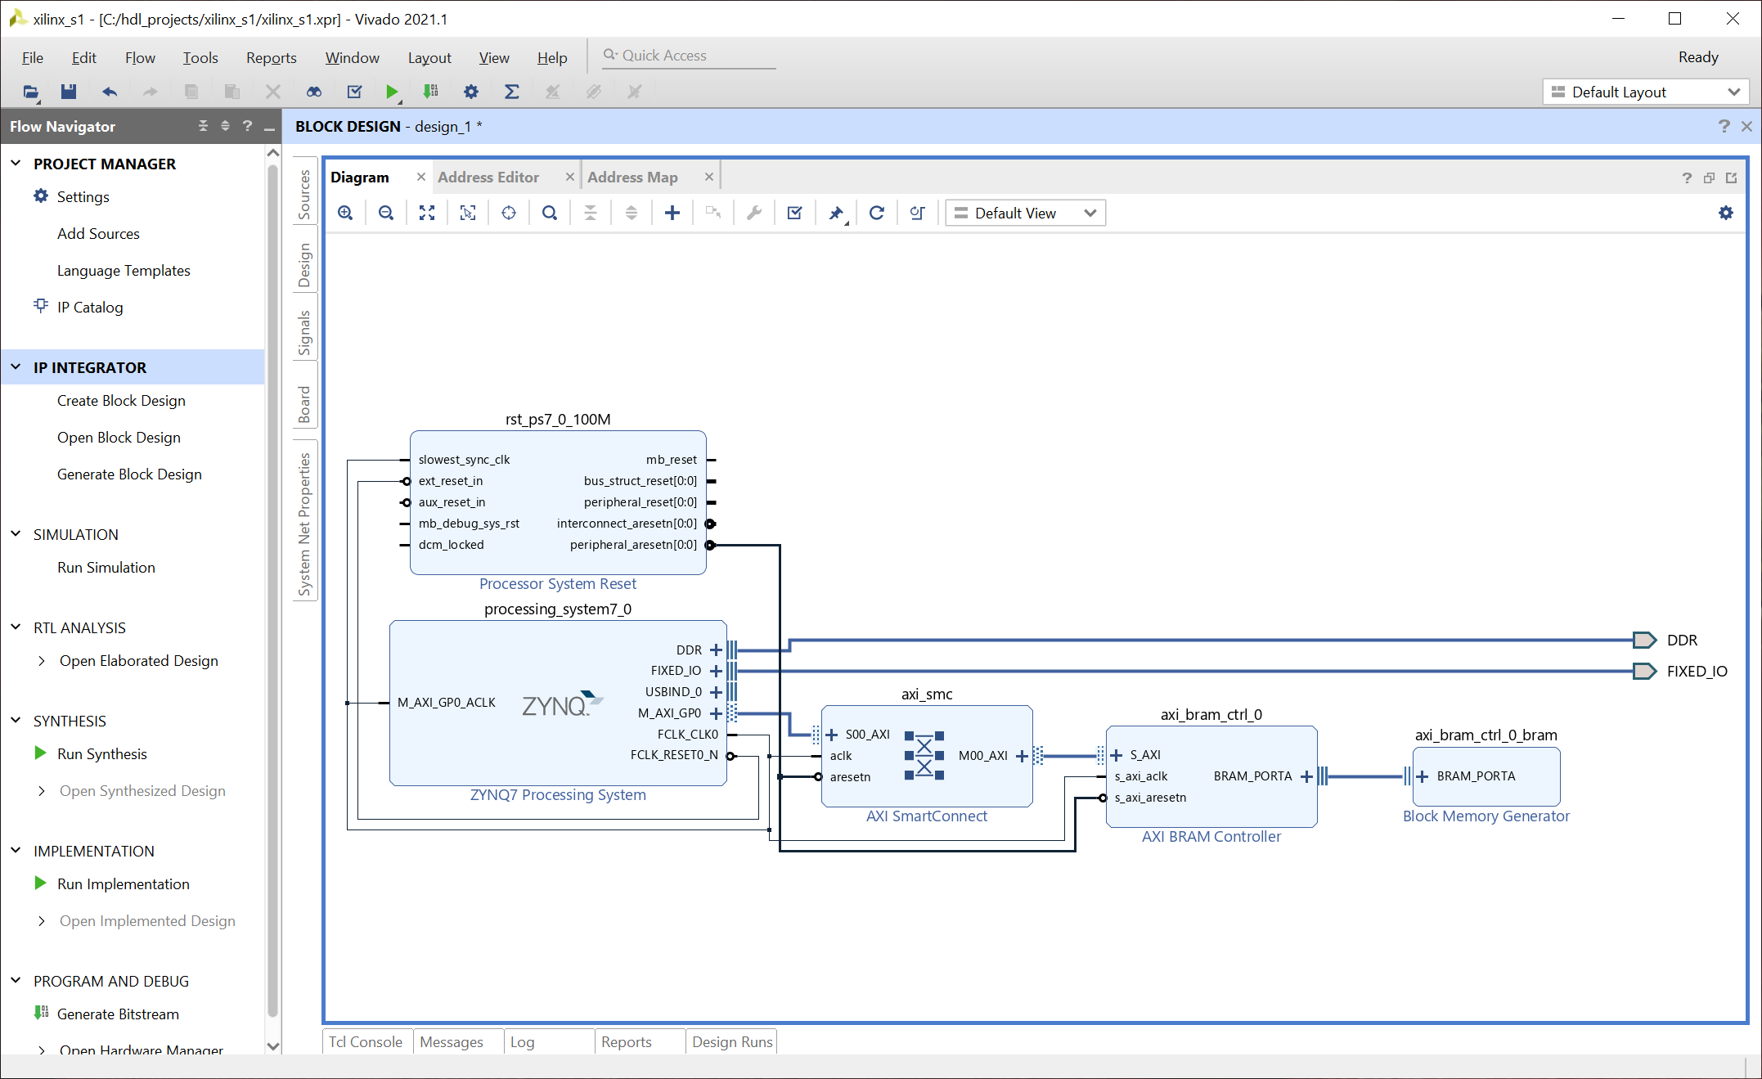
Lab 1: Understanding Vitis Project creation & Flow
Lab 1
Step 30 – Click on Validate the design

Slide 38
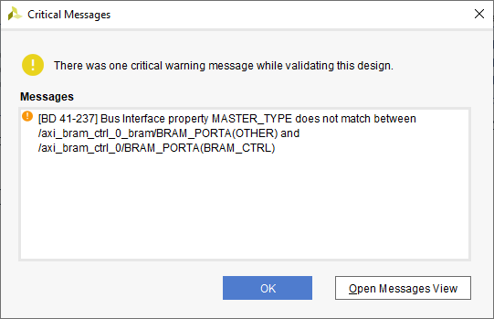
Lab 1: Understanding Vitis Project creation & Flow
Lab 1
Step 31 – Click On OK the warning is due to the change from AXI BRAM control

Slide 39
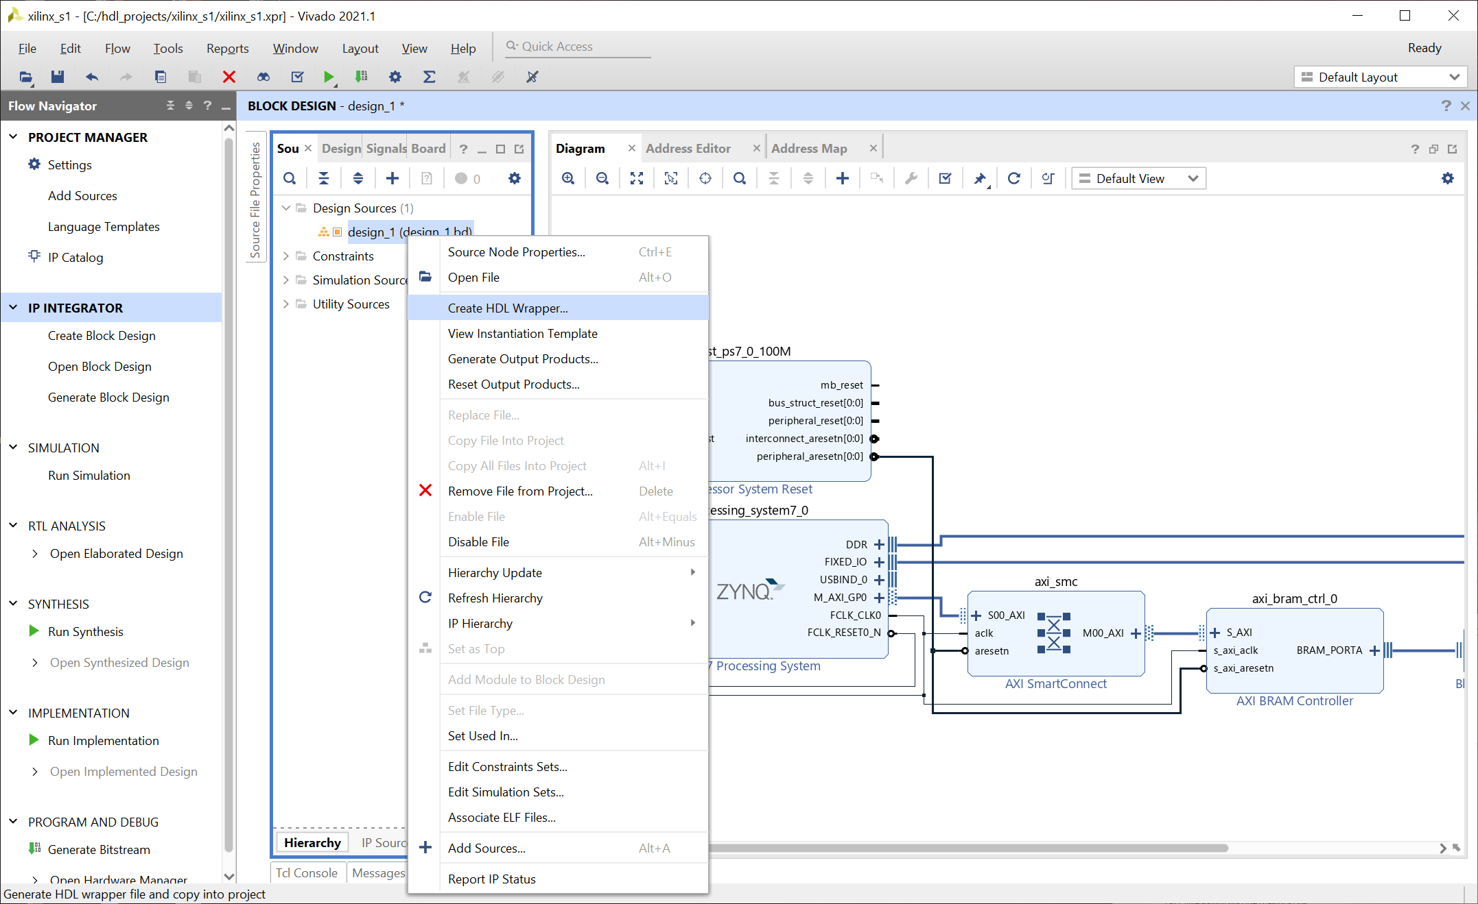
Lab 1: Understanding Vitis Project creation & Flow
Lab 1
Step 32 – In the sources tab, right click on the block diagram and select create HDL Wrapper

Slide 40
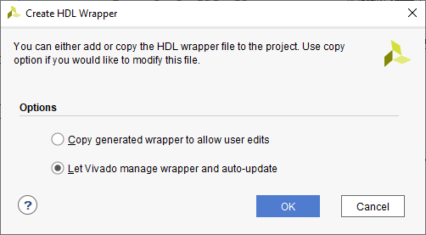
Lab 1: Understanding Vitis Project creation & Flow
Lab 1
Step 33 – leave the options as set and let Vivado manage the wrapper, click OK

Slide 41
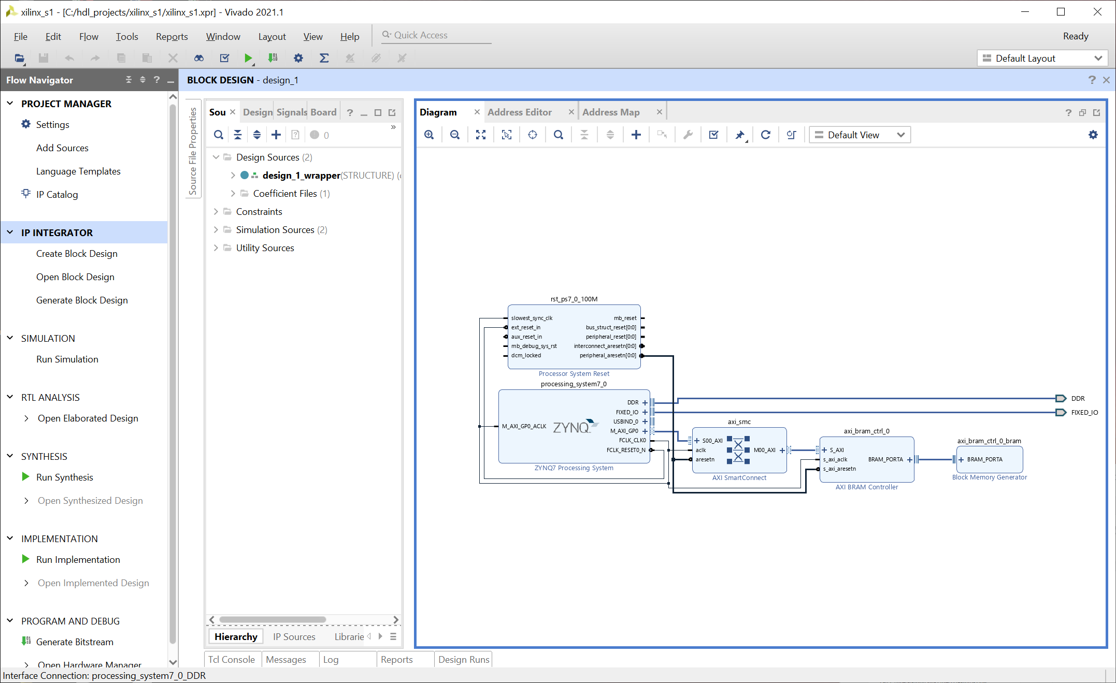
Lab 1: Understanding Vitis Project creation & Flow
Lab 1
Step 34 – Click on Generate Bit Stream

Slide 42
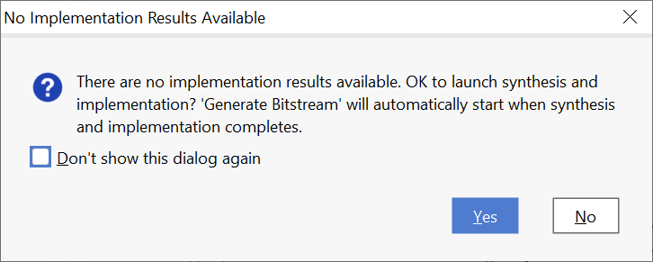
Lab 1: Understanding Vitis Project creation & Flow
Lab 1
Step 35 – Click yes

Slide 43
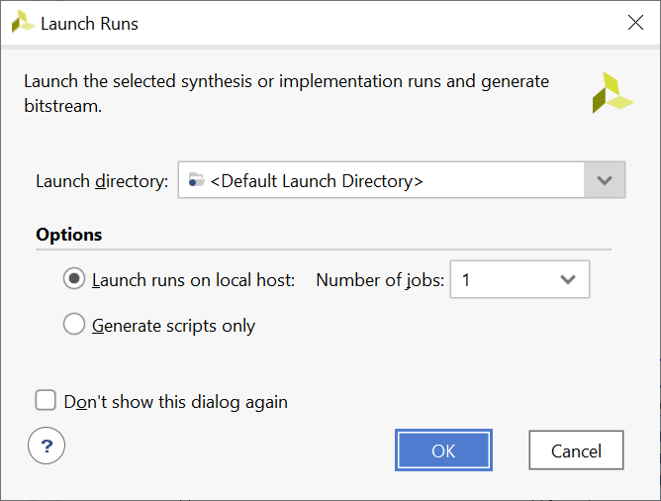
Lab 1: Understanding Vitis Project creation & Flow
Lab 1
Step 36 – Click Ok

Slide 44
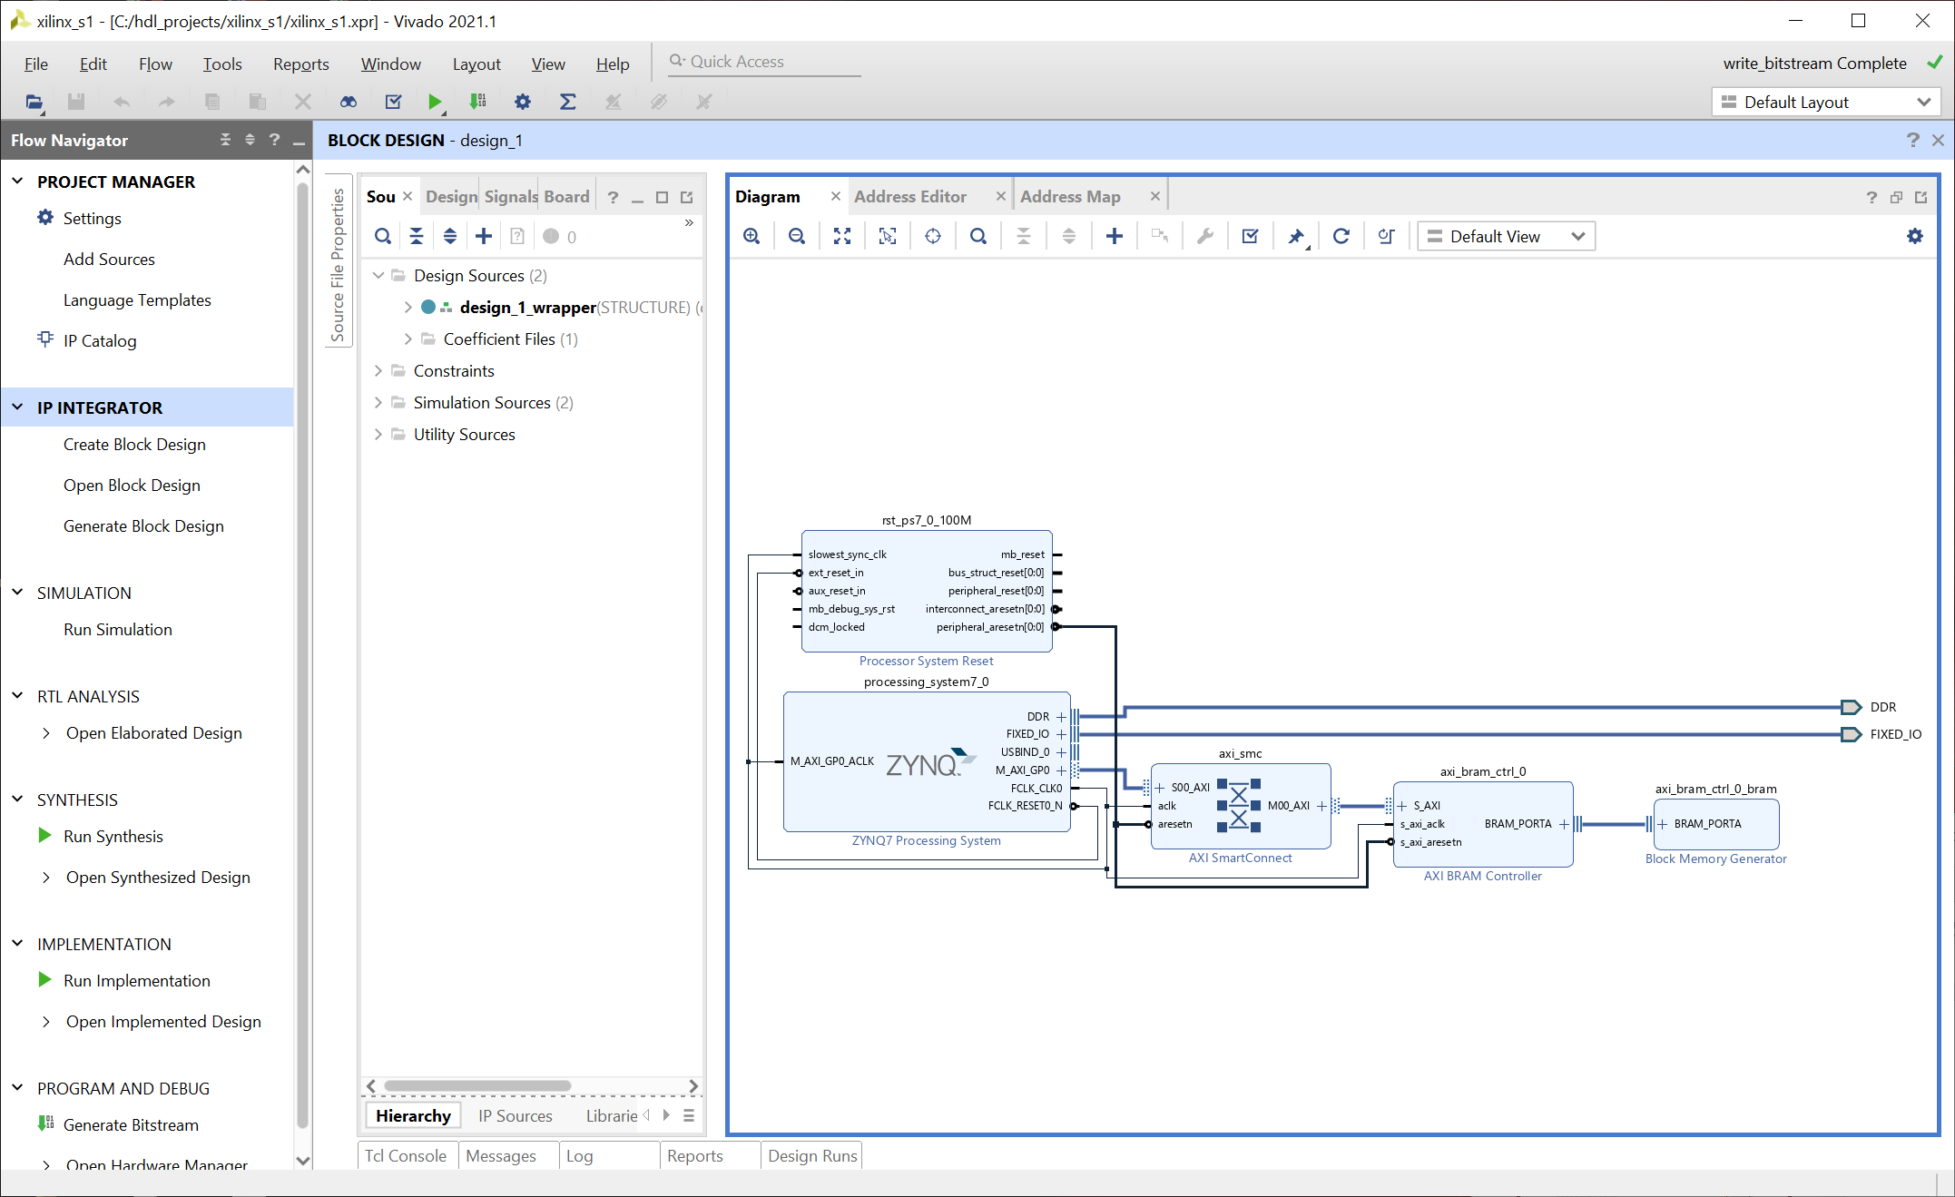
Lab 1: Understanding Vitis Project creation & Flow
Lab 1
Step 37 – Wait until the bit stream is complete

Slide 45
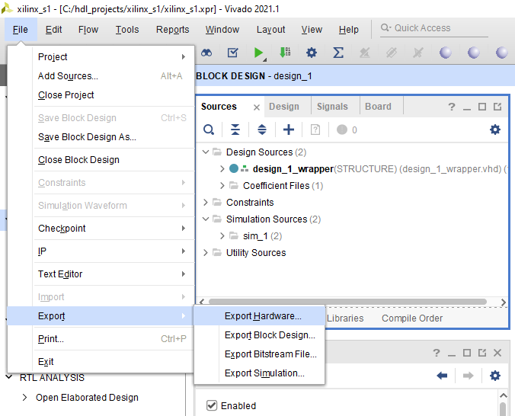
Lab 1: Understanding Vitis Project creation & Flow
Lab 1
Step 38 – From the File Menu select Export->Export Hardware

Slide 46
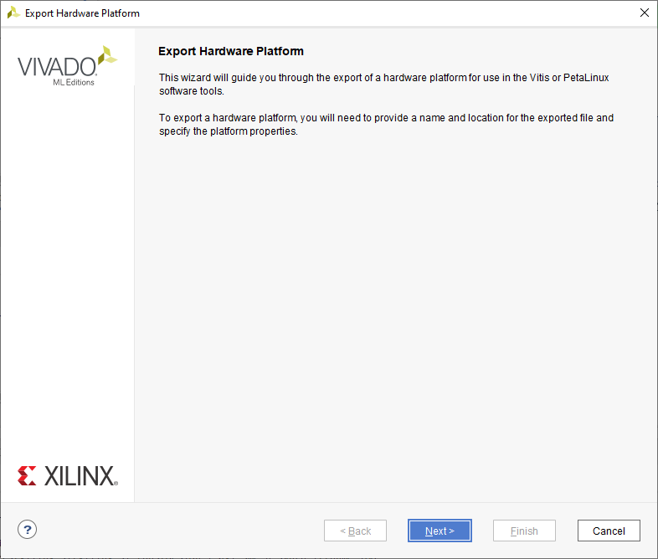
Lab 1: Understanding Vitis Project creation & Flow
Lab 1
Step 39 – Click on Next

Slide 47
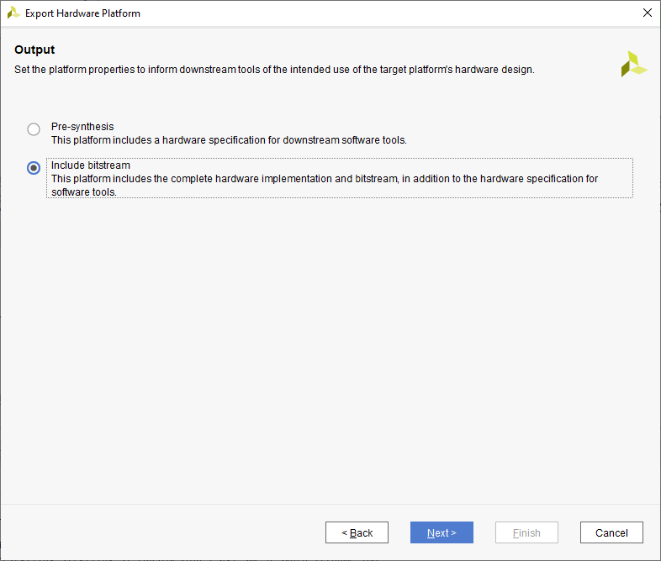
Lab 1: Understanding Vitis Project creation & Flow
Lab 1
Step 40 – Ensure Include Bitstream is selected and click OK

Slide 48
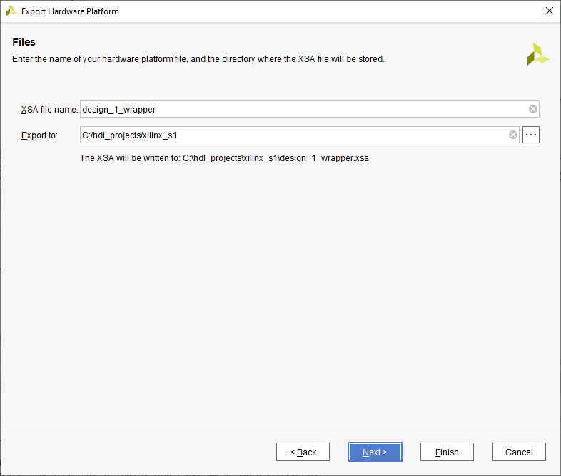
Lab 1: Understanding Vitis Project creation & Flow
Lab 1
Step 41 – Leave the defaults as is and click on Next

Slide 49
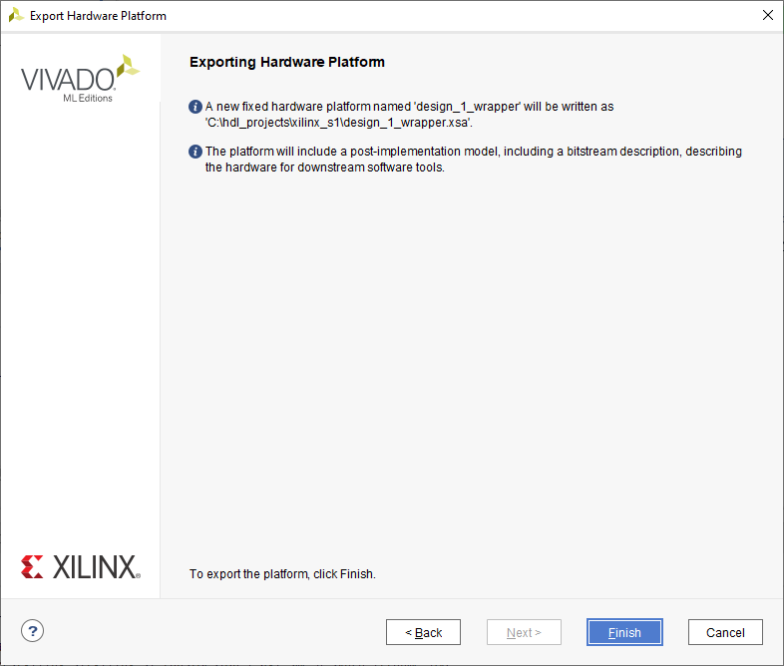
Lab 1: Understanding Vitis Project creation & Flow
Lab 1
Step 42 – Click Finish

Slide 50
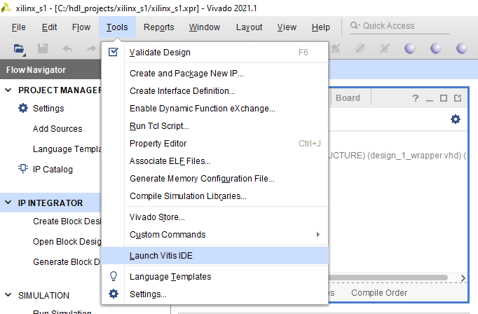
Lab 1: Understanding Vitis Project creation & Flow
Lab 1
Step 43 – From the Tools menu select Launch Vitis IDE

Slide 51
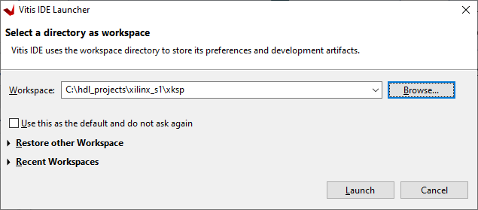
Lab 1: Understanding Vitis Project creation & Flow
Lab 1
Step 44 – At the dialog, create a new folder in your project directory and select launch

Slide 52
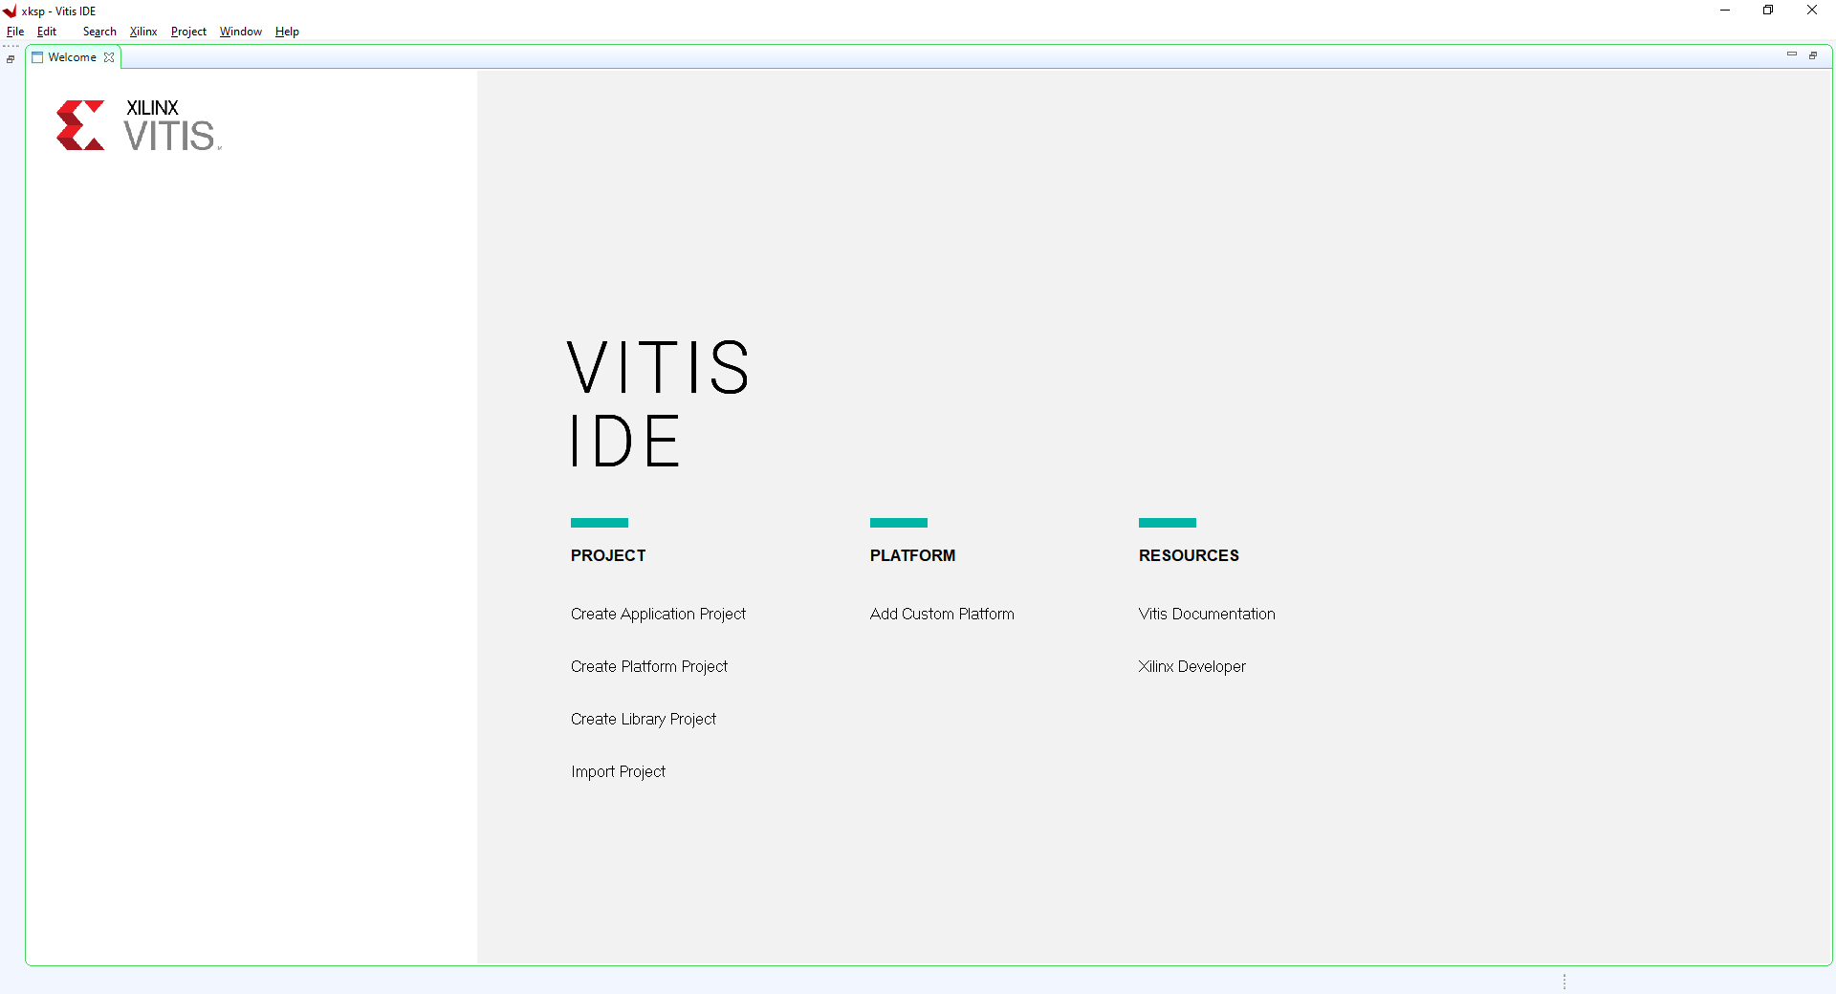
Lab 1: Understanding Vitis Project creation & Flow
Lab 1
Step 45 – Click on Create Application Project

Slide 53
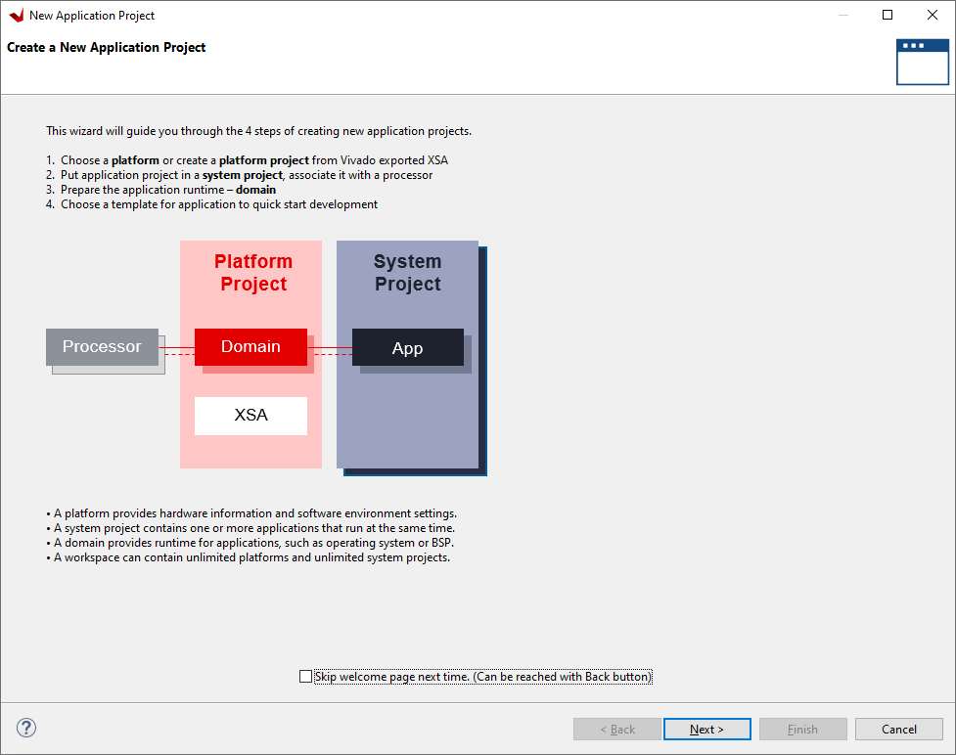
Lab 1: Understanding Vitis Project creation & Flow
Lab 1
Step 46 – Click on next

Slide 54
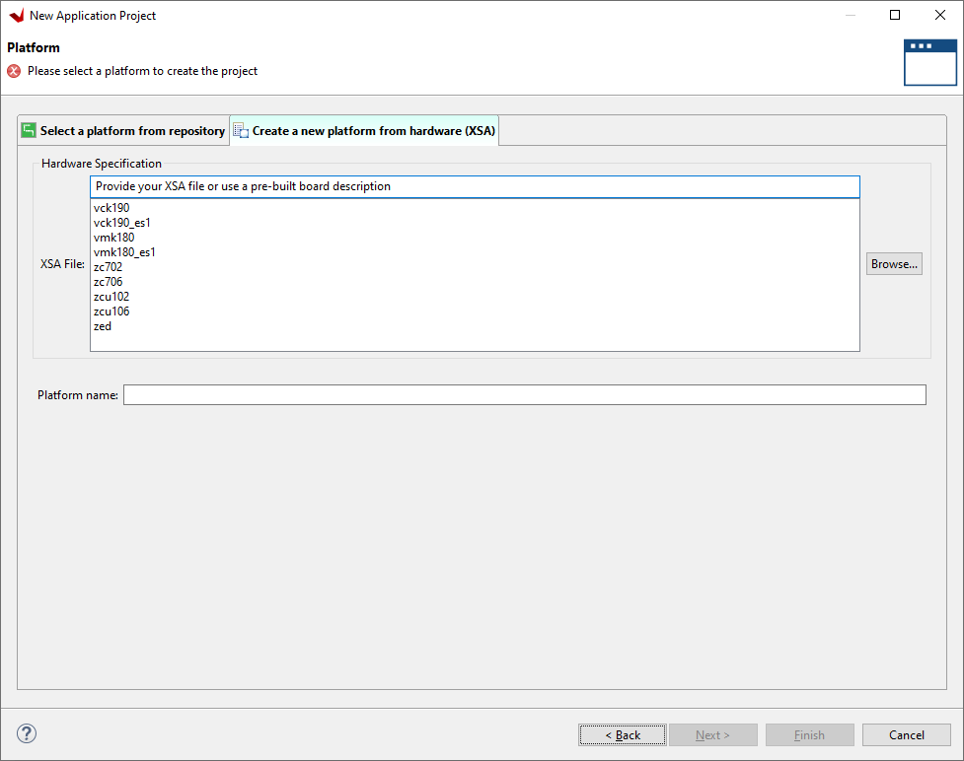
Lab 1: Understanding Vitis Project creation & Flow
Lab 1
Step 47 – Click on Create a New Platform from Hardware (XSA) and select browse

Slide 55
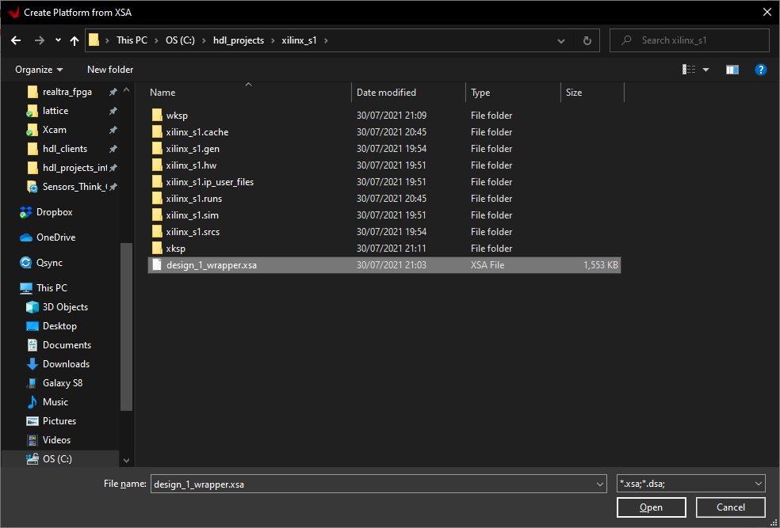
Lab 1: Understanding Vitis Project creation & Flow
Lab 1
Step 48 – Browse to the project directory, select the exported XSA and Click Open

Slide 56
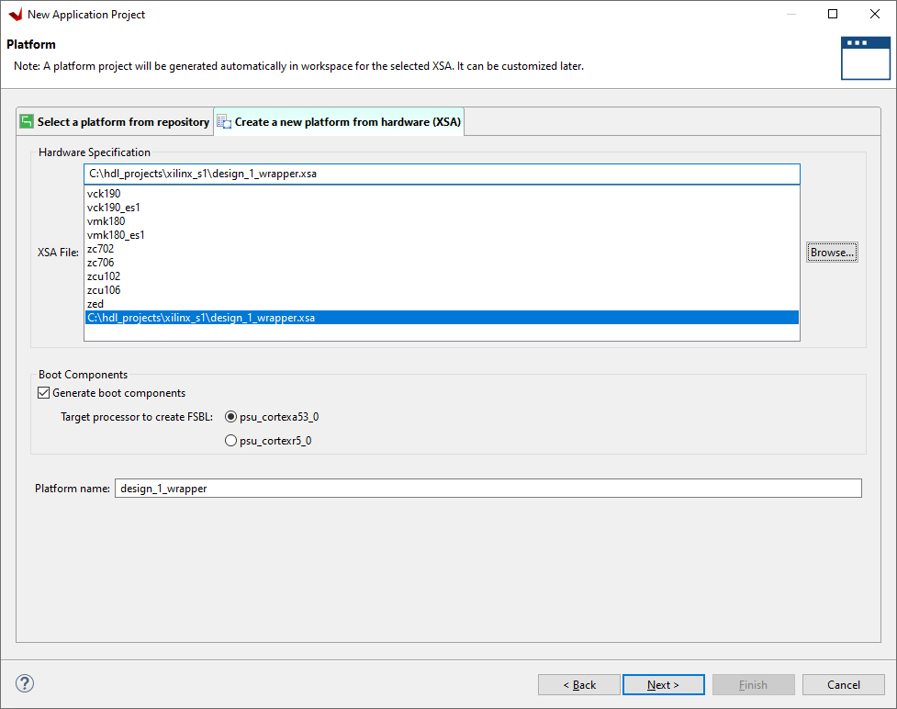
Lab 1: Understanding Vitis Project creation & Flow
Lab 1
Step 49 – Click on OK

Slide 57
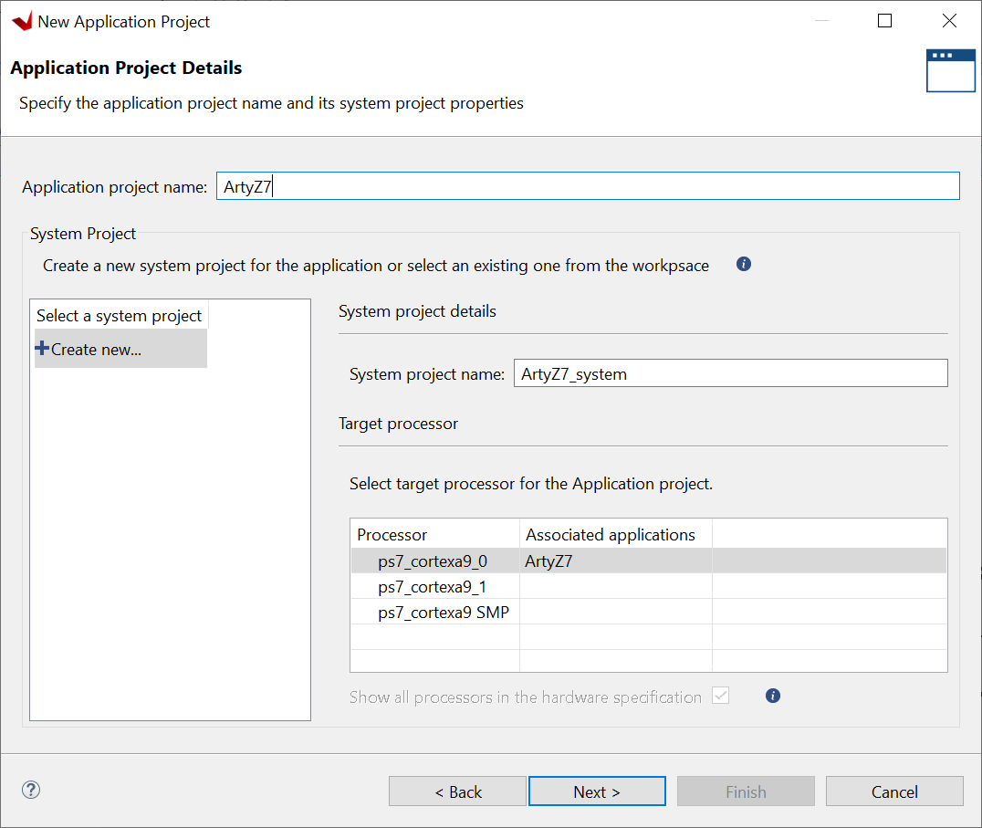
Lab 1: Understanding Vitis Project creation & Flow
Lab 1
Step 50 – Enter a project name and select Next

Slide 58

Lab 1: Understanding Vitis Project creation & Flow
Lab 1
Step 51 – Click Next

Slide 59

Lab 1: Understanding Vitis Project creation & Flow
Lab 1
Step 52 - Select Hello World and click finish

Slide 60

Lab 1: Understanding Vitis Project creation & Flow
Lab 1
Step 53 - From the application / src folder double click and open the helloworld.c

Slide 61

Lab 1: Understanding Vitis Project creation & Flow
Lab 1
Step 54 - Click CNTRL-A to select all the code in the file and delete it

Slide 62

Lab 1: Understanding Vitis Project creation & Flow
Lab 1
Step 55 - Copy and paste in the code from the Github repo session one lab

Slide 63

Lab 1: Understanding Vitis Project creation & Flow
Lab 1
Step 56 - Click on the Hammer to Build the project

Slide 64

Lab 1: Understanding Vitis Project creation & Flow
Lab 1
Step 57 - It will take a few minutes to compile. Successful completion will show as below

Slide 65

Lab 1: Understanding Vitis Project creation & Flow
Lab 1
Step 58 - Connect the USB to the ArtyZ7, Check the book Mode is JTAG. Power on the board.

Slide 66

Lab 1: Understanding Vitis Project creation & Flow
Lab 1
Step 59 - From the assistant view, right click on debug and select debug-> launch on Hardware. This will configure the ArtyZ7, download the PL and the application.

Slide 67

Lab 1: Understanding Vitis Project creation & Flow
Lab 1
Step 60 - The application will pause at the first instruction on the ArtyZ7. Click the Run Arrow

Slide 68

Lab 1: Understanding Vitis Project creation & Flow
Lab 1
Step 61 – Project will run, Click on Vitis Serial Terminal and Click +

Slide 69

Lab 1: Understanding Vitis Project creation & Flow
Lab 1
Step 62 – Add the following settings to the pop up and click ok

Slide 70

Lab 1: Understanding Vitis Project creation & Flow
Lab 1
Step 63 – Check the terminal window, secret word should be detected correctly

